Slide 1
Home Economics
Philosophy(ies)
Sue L. T. McGregor PhD Professor
Faculty of Education, Mount Saint Vincent University Halifax NS Canada
http://www.consultmcgregor.com
Keynote at Fifth International Scientific Conference
Rural Environment. Education. Personality (REEP)
Jelgava, Latvia

Slide 2
4 Ps of Any Profession
Profession – provides a set of services that are beneficial to society as a whole
Professional – person practicing in a profession, drawing on general AND specialized knowledge and guided by high standards of professional ethics
Practice – identifiable, repeatable action pursued as an inherent part of a given profession
Philosophy – ideas (beliefs, set of rules and principles) about what is important in order to achieve high quality and ethical, normative practice

Slide 3
Home Economics is a PROFESSION
Provides services to society that focus on the home and family for the betterment of humanity (optimize well-being and quality of life)
The provision of these services involves rigorous and responsible intellectual activity, especially moral judgements
Home economists continually critique existing knowledge to see how (if) it matches the evolving needs of individuals and families

Slide 4
Home Economics is a Profession con’t
Home economists engage in personal reflection and self-critique to ensure their work is morally defensible; their intent is to present themselves in such a way that society is very clear about what the profession offers to society
Because of the high level of ethical competence and independent, intellectual thought required to practice home economics, the scope and purpose of the profession is necessarily limited; however… the complexity of the knowledge and of practice is not limited, and is, in my opinion, ideally informed by a philosophy(ies) of practice.

Slide 5
Philosophy
From Greek philosophia
"love of knowledge, wisdom”

Slide 6
More on Philosophy
Contributes to the other Ps (especially professionalism and practice) because it offers goals, values and attitudes for which to strive when practicing
Helps practitioners be aware of what they are doing and why they are doing it; helps them better appreciate and understand their professional actions
Can be used to help interpret, organize and use information and perspectives while making decisions about practice and taking particular actions (or not)

Slide 7
Role of Philosophies
A philosophy of practice helps practitioners make decisions that lead to the formation of ethically consistent, morally defensible practice that impacts the human condition, as shaped by daily life within homes and families.
Without a philosophy of practice, home economists cannot know what is motivating them to make very large decisions with moral overtones (people can be harmed if the wrong decision is made).

Slide 8
Philosophies con’t
A philosophy defines 4 Rs of practice:
  The rules (principles, values, beliefs, attitudes) of practice
  The roles that practitioner must fulfil and respect
  The relationships they must manage, lead and mentor
  The responsibilities they have for the discipline, the profession and for their ‘clients’ or ‘partners’

Slide 9
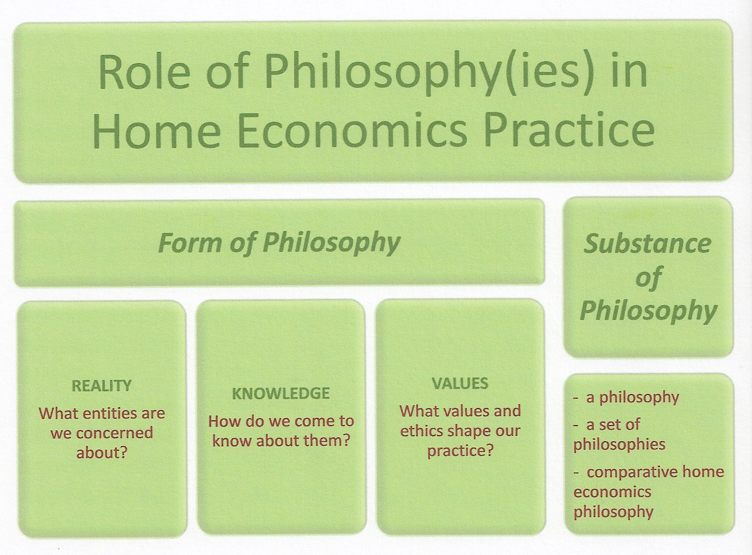
A philosophy can have both form and substance

Slide 10

Philosophical Form versus Substance
FORM
Our focus, how we come to know about it, and what values and ethics shape our practice
SUBSTANCE
The unique perspective we bring to our view of the form of our philosophy; it sets boundaries to our practice and gives meaning to our work.

Slide 11
Current, Accepted Philosophical Form of Home Economics
Individuals and families (alone and as social institutions) are our focus (reality).
We come to know about them by studying their day-to-day lives lived out in their homes and households, shaped by internal and external factors (knowledge).
The intent is to improve and enhance, and make as best as possible (optimize), their well-being, quality of life and everyday life (values and valued ends).

Slide 12

In summary, philosopical Form is the framework for professional action:
– what entities, how we come to know them and why

Slide 13
Philosophical Substance of Home Economics (Latin substatia for that which stands under or underlies)
The substance of a philosophy entails the creation of a unique perspective on our phenomenon of interest – families.
What is our unique perspective on families? What gives meaning to, and what sets boundaries for, our professional practice?
What is the substance of our philosophy? What underlies our practice?

Slide 14
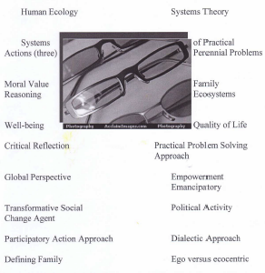
Substance of long standing home economics philosophy in most parts of the world...

Slide 15
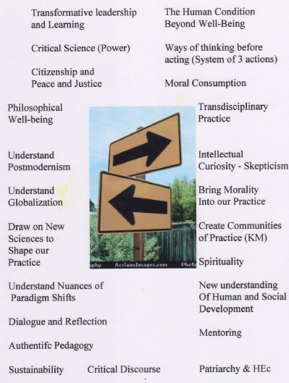
Evolving philosophical ideas (suggested changes to form and mostly substance)

Slide 16
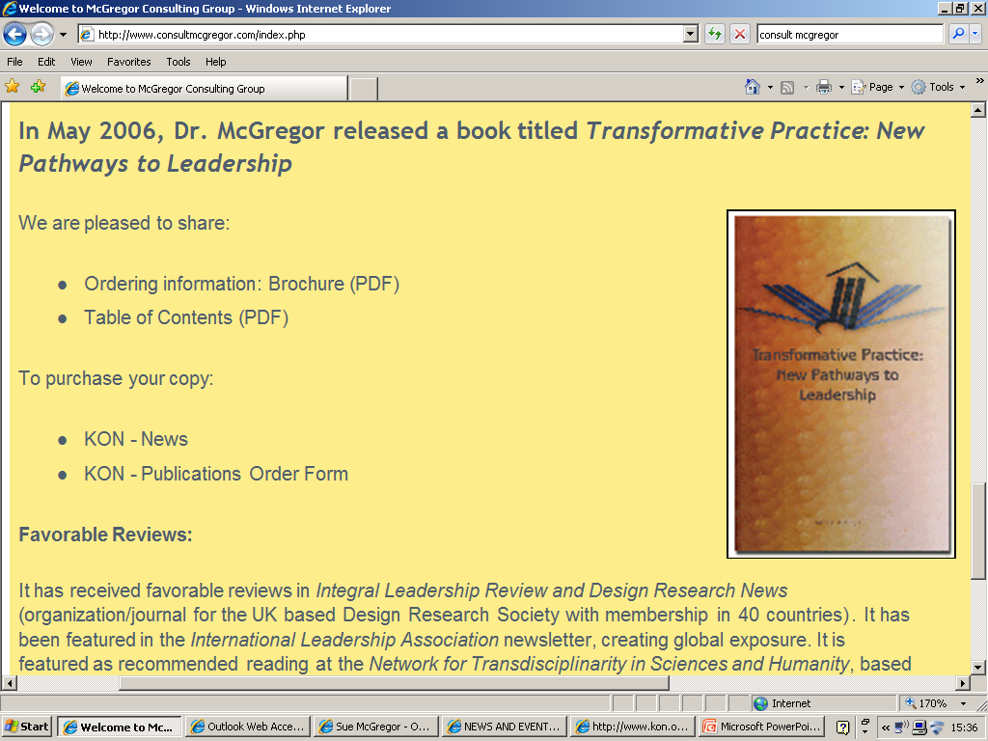
These ideas are set out in more detail in my 2006 book, Transformative Practice and at my professional website http://www.consultmcgregor.com

Slide 17

Various approaches to the substance of home economics philosophy (our unique perspectives on practice with families that underlie our work and our thinking)
A philosophy of home economics
Philosophies of home economics
Comparative home economics philosophy(ies)

Slide 18
Three approaches to the substance of home economics philosophy con’t
A philosophy - agreed-to world-wide professional philosophy may mean a more sustainable profession on a global scale, a deeper assurance of consistency in practice, a stronger ability to ride the currents of change, and a far-reaching sense of solidarity (same form and same substance).
Philosophies - each region would embrace a context-specific home economics philosophy (different form and different substance).
Comparative - respect the global diversity of home economics practice (over time, regions and cultures), perhaps with an agreed-to form, but with different substance, or different forms but the same substance, depending upon the context. KEY -through constant comparisons and dialogue, the form and substance may change.

Slide 19
Summary
Same Form, Same Substance
Different Form, Same Substance
Different Form, Different Substance
Same Form, Different Substance
Comparative Philosophies
A Philosophy
Philosophies

Slide 20
ALSO, I have come to realize that home economics philosophy (form and especially substance) is not the same around the world because practitioners in different countries use different philosophers...

Slide 21

For example…
North America and Oceania – Habermas (German, 1900s-2000s)
Europe and Scandinavia – Merleau-Ponty, Husserl and Heidegger (German and French,1800s-1900s )
Japan – Bollnow (German, 1900s)
China – Confucius (thousands of years ago)

Slide 22
And, they ignored other philosophers… a conversation for another day!
Karp Popper
Jean-Paul Sartre
Michel Foucault
John Dewey (maybe in home economics education)
Friedrich Nietzsche
Karl Marx
John Stuart Mill
Noam Chomsky
http://users.ox.ac.uk/~worc0337/philosophers.html

Slide 23

Philosophical Diversity
The identify of who we turn to for philosophical insights matters because if the substance of our philosophy of practice changes, so must our ideologies, research methodologies, theories, methods, results reporting and applications in practice.
Given the existing diversity in philosophers that home economists tend to draw upon, it stands to reason that what is considered a philosophical framework for home economics might differ around the world.

Slide 24
Examples of diversity of opinions about what counts as home economics philosophy
Canada
  Transdisciplinarity, transformative, philosophical well-being, focus on human condition
United States
  Reflective leadership, critical science, qualities of living, communities of practice
Europe and Scandinavia
  Competent thoughtful practice, sacred everyday life, narratives, integral specialists
Australia
  Carnival(esque), expert novice, beyond patriarchy, convergent moments, generational theory, future-proofing
Asia (especially Japan)
  Visualize humane society, human protection, home as habitation, civil minimum
  Taken from a study I did in 2009

Slide 25
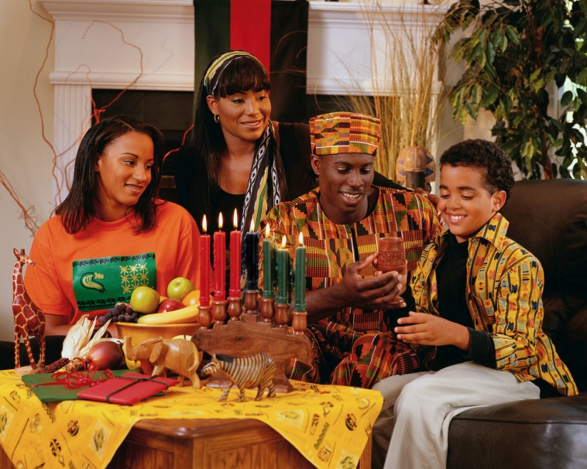

REMINDER
FORM
Our focus, how we come to know about it and why
SUBSTANCE
The unique perspective that underlines and underpins our practice

Slide 26
Examples of diverse thoughts on home economics philosophy
embrace new notions of what it means to be an expert (expert novice and integral specialist) (substance)
consider the idea of having fun and taking pleasure while practising on the margins, and of resisting normalization (carnival and carnivalesque) (substance);
move far beyond interdisciplinary to the intellectually energizing spaces of transdisciplinarity and integral thinking (substance);
embrace celebratory, reflective leadership with a focus on human action (ethical, spiritual and authentic) and human as well as intellectual and philosophical capital, rather than conventional management and transactional leadership (form and substance);
choose to focus on the human condition, basic human needs and qualities of living rather than just well-being and quality of life (form);

Slide 27
Examples of diverse thoughts on home economics philosophy
use new conceptualizations of the home (the house as a place for humanity and the ascendency of human beings rather than just shelter for individual families) (form);
consider the concepts of wholesight and being-in-the-world (substance);
conceive our body of knowledge as agent-centered rather than subject- or content-centered (facilitated through communities of practice instead of separate specializations) (substance);
show a newfound respect for everyday life, especially how people make sense and meaning within their daily life (form);
adopt different notions of what competent practice looks like (predicated on sustainability of culture and society, personal and social responsibility, and a willingness to live and manage together) (substance)

Slide 28
Examples of diverse thoughts on home economics philosophy fini
accept the idea that everyone on earth has a right to basic education for life competence (a rights-based approach) so as to foster the culture of family life (form and substance);
move away from integrated practice to integral practice (shift from balance and harmony to a respect for the emergent and healthy tensions that hold things together as they continually evolve in an attempt to see order emerging in chaos) (substance);
position the profession beyond patriarchy (substance); and,
consider the restoration of humanity by viewing home economics as a discipline for human protection focused on the soundness and fullness of human life and existential hope (based on the assumption that the destruction of private life leads to the destruction of the conditions of humans in general) (form and substance)

Slide 29
What would happen to the substance of our philosophy if the form of home economics changed?
CURRENT FORM
Individuals and families (alone and as social institutions) are our focus (reality). We come to know about them by studying their day-to-day lives lived out in their homes and households, shaped by internal and external factors (knowledge). The intent is to improve, optimize and enhance their well-being and quality of life (values and valued ends).
POSSIBLE NEW FORMS
Study individuals and families and their art of everyday living and how this helps the home become the protector of humanity
Focus on the human family and study how the home performs in the arena that shapes the human condition
Focus on family as a social institution and how various societies respect (or not) this institution as the cornerstone of humanity

Slide 30
WHY does home economics philosophy matter (both our focus and our approach)?
We are making professional decisions (ethical and moral) about problems facing humanity (lived out in families) that may not have solutions in our lifetime.
We need deep-rooted ideas about what should guide our mission-oriented practice, which is focused on morally laden, practical, perennial problems faced by families, problems that span generations, but need different solutions.

Slide 31
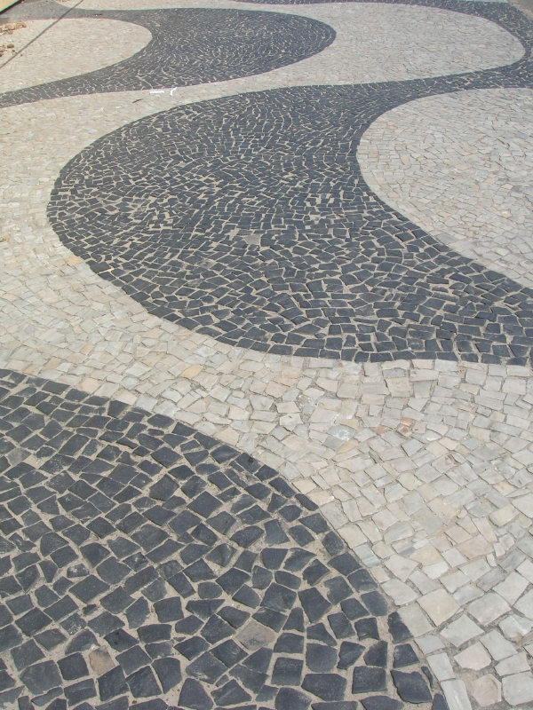
Philosophical Mosaic
We are not isolated islands. We belong to the worldwide profession of home economics, with members practicing in almost 200 countries. Given this contextual professional mosaic, we can anticipate a philosophical mosaic as well.
Given our moral responsibility to humanity, home economics must continue to (a) engage in collective dialogue about the topic of philosophy(ies) in practice, and (b) work together to create practice that is consistent with the valued ends of the profession (philosophical form and substance)

