Slide 1
Integral Leadership
Informed by Ken Wilber’s Theory of Everything and The Integral Vision and Beck and Cowan’s Spiral Dynamics Approach
Sue McGregor January 2010
Recommended Citation: McGregor, S. L. T. (2010). Integral leadership : Graduate Leadership Course materials. Mount Saint Vincent University, Halifax NS.

Slide 2
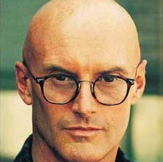
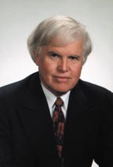
My understanding of integral is informed by the thoughts of ken wilber
As well as the Spiral Dynamics idea from
Don Beck (here) and Chris Cowan

Slide 3
Integral versus integrated
Integrated and integral stem from the Latin root integrare, which means to make whole or make complete – to become one
it means to form into a whole or to be introduced into another entity
it can mean resembling a living organism
it can mean the process of fitting in
the whole comes about as a result of coordination and intentional composition
Being integral means being an essential part of a whole thing
However, these two concepts achieve wholeness and completeness quite differently...

Slide 4
Integrated
Integrated means balance, equilibrium and harmony – minimize tension and reduce chaos
Integral
Integral (when used in integral theory) means emergent and healthy tension that holds things together as they evolve – these tensions provide order in the chaos

Slide 5
Integrated
strives for:
certainty
order
sureness
Places a lot of emphasis on harmony within systems
Integrated strives for uniformity of similar things
Leads to a constrained sense of reality
Integral
respects:
uncertainty
disorder
insecurity
Respects the creative, dynamic and evolving nature of human and natural processes
Integral strives for a sense of unity in differences (emphasizes unity as much as diversity)
Leads to a fuller sense of reality.

Slide 6
Integral leaders
Pursue life enhancing and sustainable organizations and social processes
Realize the need to understand the nature of human consciousness and how it affects humanity’s development
Focus on human capacities that transcend lower levels of human consciousness and development
Believe that humans have the potential to continually evolve in a complex world
Invite people to grow and develop their potentials to the best of their abilities
Deeply respect integration of multiple perspectives (especially the integration of insights from science, art, religion and morals)

Slide 7
Tenets of integral leadership
focus on complex, emergent world problems (not just complicated problems)
they do so by valuing both external, material factors shaping the leadership process (behaviors, skills, strategies, structures, and processes) and internal consciousness factors (thinking, feeling and values)
Their integral vision includes the integration of science, art, morals, and religion
Their integral vision weaves matter, body, mind, soul and spirit all together, a Living Totality
They are on a journey, not aiming for a destination

Slide 8
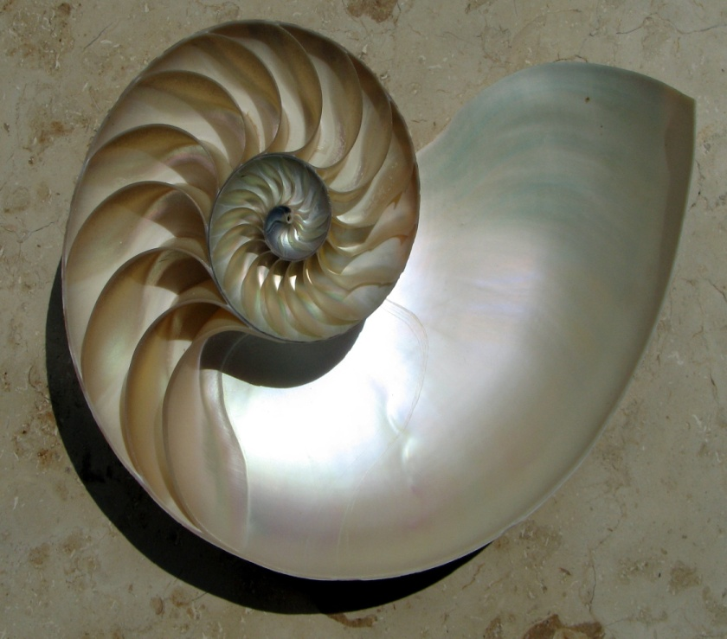
Tenets continued
They appreciate that the horizon constantly retreats as they approach it, a disconcerting fact of integral life
Better yet, people approach the horizon journeying along a spiral path rather than a straight path. Progress unfolds as a series of unfolding, interconnected, overlapping events (waves) rather than distinct steps
Employ the spiral metaphor to their life (dynamic, unfolding, revealing, progressive). A spiral is a curve that starts from a central point and gets further away from the point as it unfolds (but still stays connected to the starting point).

Slide 9
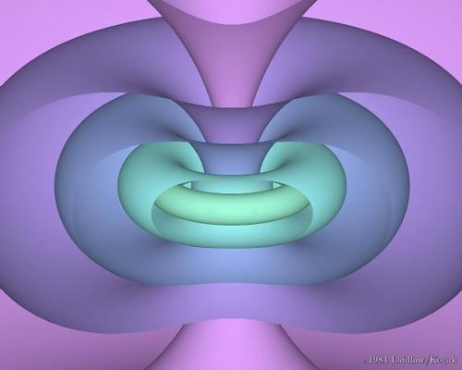
Tenets continued
They believe that everything happens in relationship to everything else
They are open and able to modify their value constellations, often resulting in changing their entire life purpose
Appreciate the integration of each of progression, development, growth and evolution
View life through the lens of holons
(a whole/part)
know that weaving together a collection of views and perspectives brings us closer to the theory of everything

Slide 10
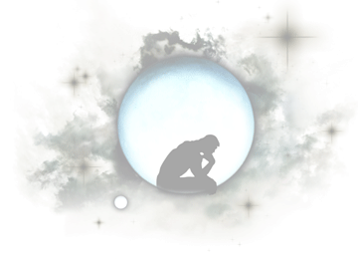
Intent of integral leadership
Intent is to be as comprehensive, inclusive and caring as possible while striving for deep, luminous clarity of the situation
the intent is to scan all elements to gain integral insights (self, science, the collective, and the web-of-life systems)
With this integral vision leaders are closer to making sense of everything (the theory of everything).
There is no right or wrong. There is a place for everything.
MAJOR ISSUE is “how much complexity is needed to adequately understand the situation from a holistic, integral perspective?”

Slide 11
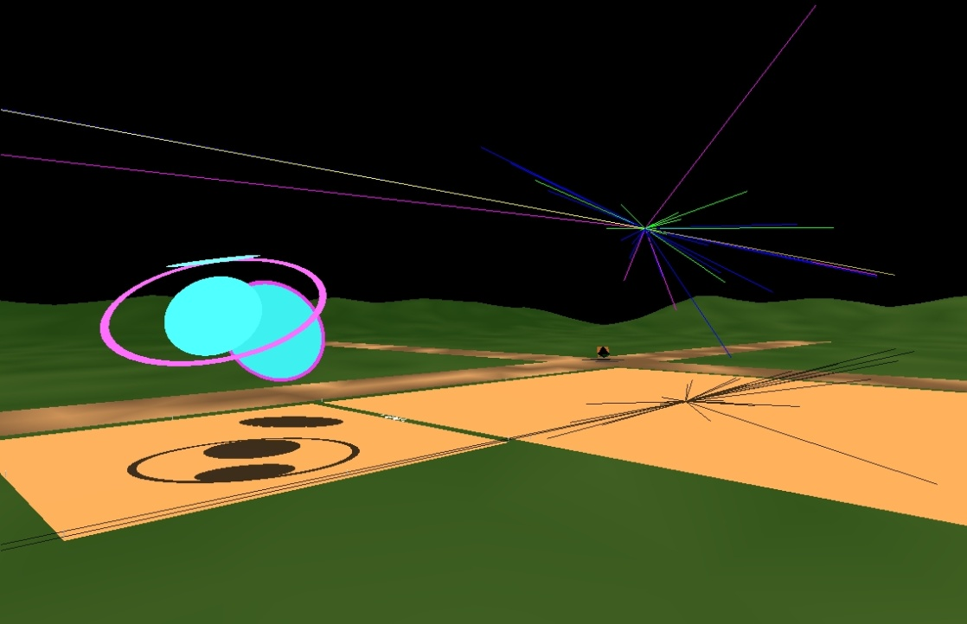
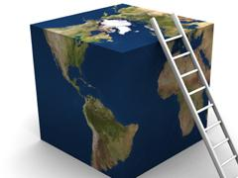
Failure to find this integral vision by looking at many perspectives to deal with complexity, means people lead on a flatland - they fail to grasp the full spectrum of human consciousness and development.
Living on a flatland means people are living life with no integration of different perspectives and worldviews.
Leaders operating on the flatland lose too many viewpoints – they cannot see around the many corners to gain other perspectives that might inform their complex problem solving.

Slide 12
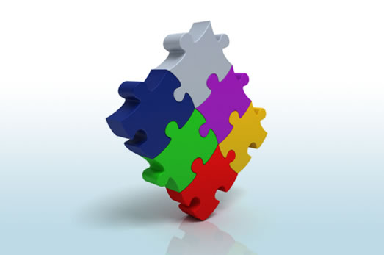
Some sort of integration (pun intended)
Relationships and connections
Chaos and tension
Emergence and complexity
Collection of views and perspectives
Integrate science, art, morals and religions
Integrate matter, body, mind and soul
Integrate physical, mental, emotional and spiritual
Integrate I/me, we, it and its
Integrate first (I), second (we) and third (it and its) persons to create fourth person

Slide 13
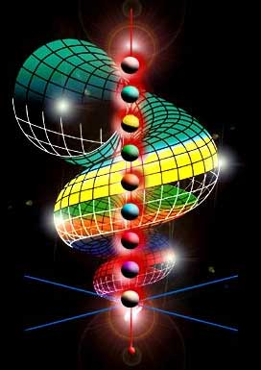
Nine levels of human consciousness – spiral dynamics
Tier 1 (99%)
Level 1 – instinctive
Level 2 – magical
Level 3 – egocentric
Level 4 – mythic
Level 5 – scientific and materialism (30%)
Level 6- humanistic and sensitive-self in relation to others (10%)
Tier 2 (1%)
Level 7 – integration of complex systems
Level 8 – holistic, global and the unknown
Tier 3 (0%)
Level 9 – integral (vision logic)

Slide 14

Spiral metaphor so leaders do not have to live on the flatland
People tend to see the world as partisan (fragmented in parts) – we need to shift to wholism (things are interconnected) and evolutionary
Tier Thinking (From Spiral Dynamics theory) – nine levels
Tier 1 - people see the world in parts, from individual perspectives with no integration (6 levels)
Tier 2 - When the light comes on, the aha moment when people are able to finally see the big-picture rather than the parts, they have jumped to second-tier thinking: integration and synergy of many perspectives and ultimately, the emergence of integral-holonic thinking (2 levels)
Tier 3 - integral-holon thinking; often called visionaries, able to establish tensegrity, short for tension integrity. They are able to respect a semi-stable mix of order and chaos and accept that people are capable of self-stabilizing by redistributing and diluting stress on systems (1 level)

Slide 15
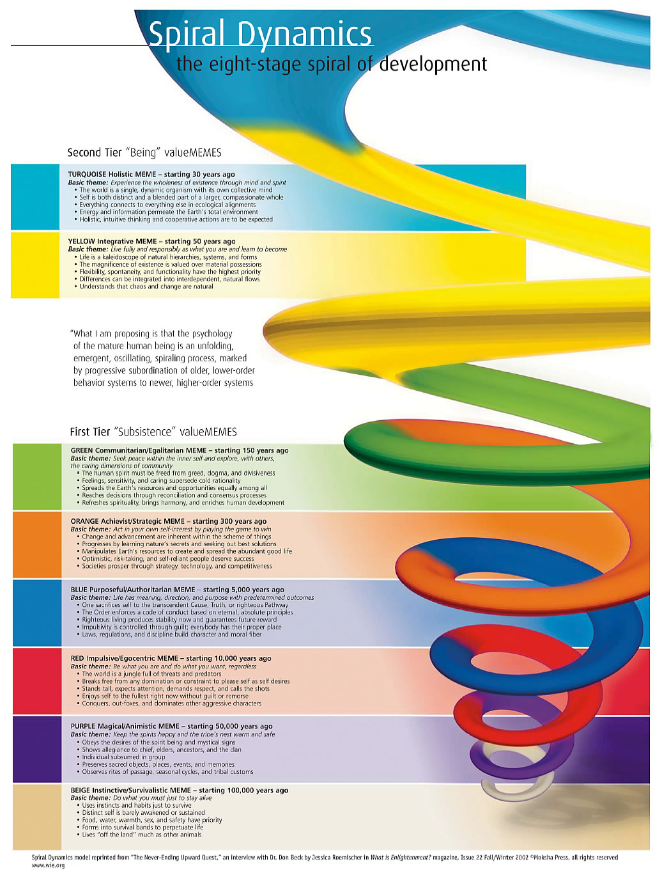
Wilber adds a Third Tier with a ninth level
– integral holon
– indigo color

Slide 16
Wilber’s addition of Five elements (AQAL)
STATES – progression – temporary but build on each other
STAGES – development – permanent but take a long time to come into being (stages unfold sequentially and cannot be skipped)
LINES – growth – dynamic (unfold through the stages- can be straight, wavy, spiral, streams, waves)
TYPES – evolution – permanent personality traits (styles, voices, logics, typologies)
QUADRANTS – four equal parts – all are needed to make the whole

Slide 17
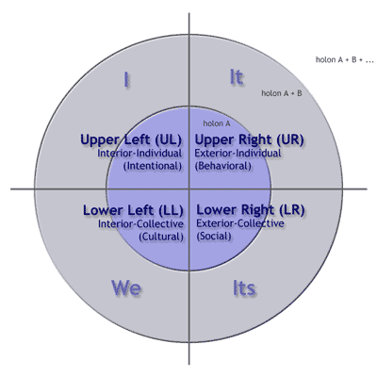
All Quadrants All Levels AQAL

Slide 18
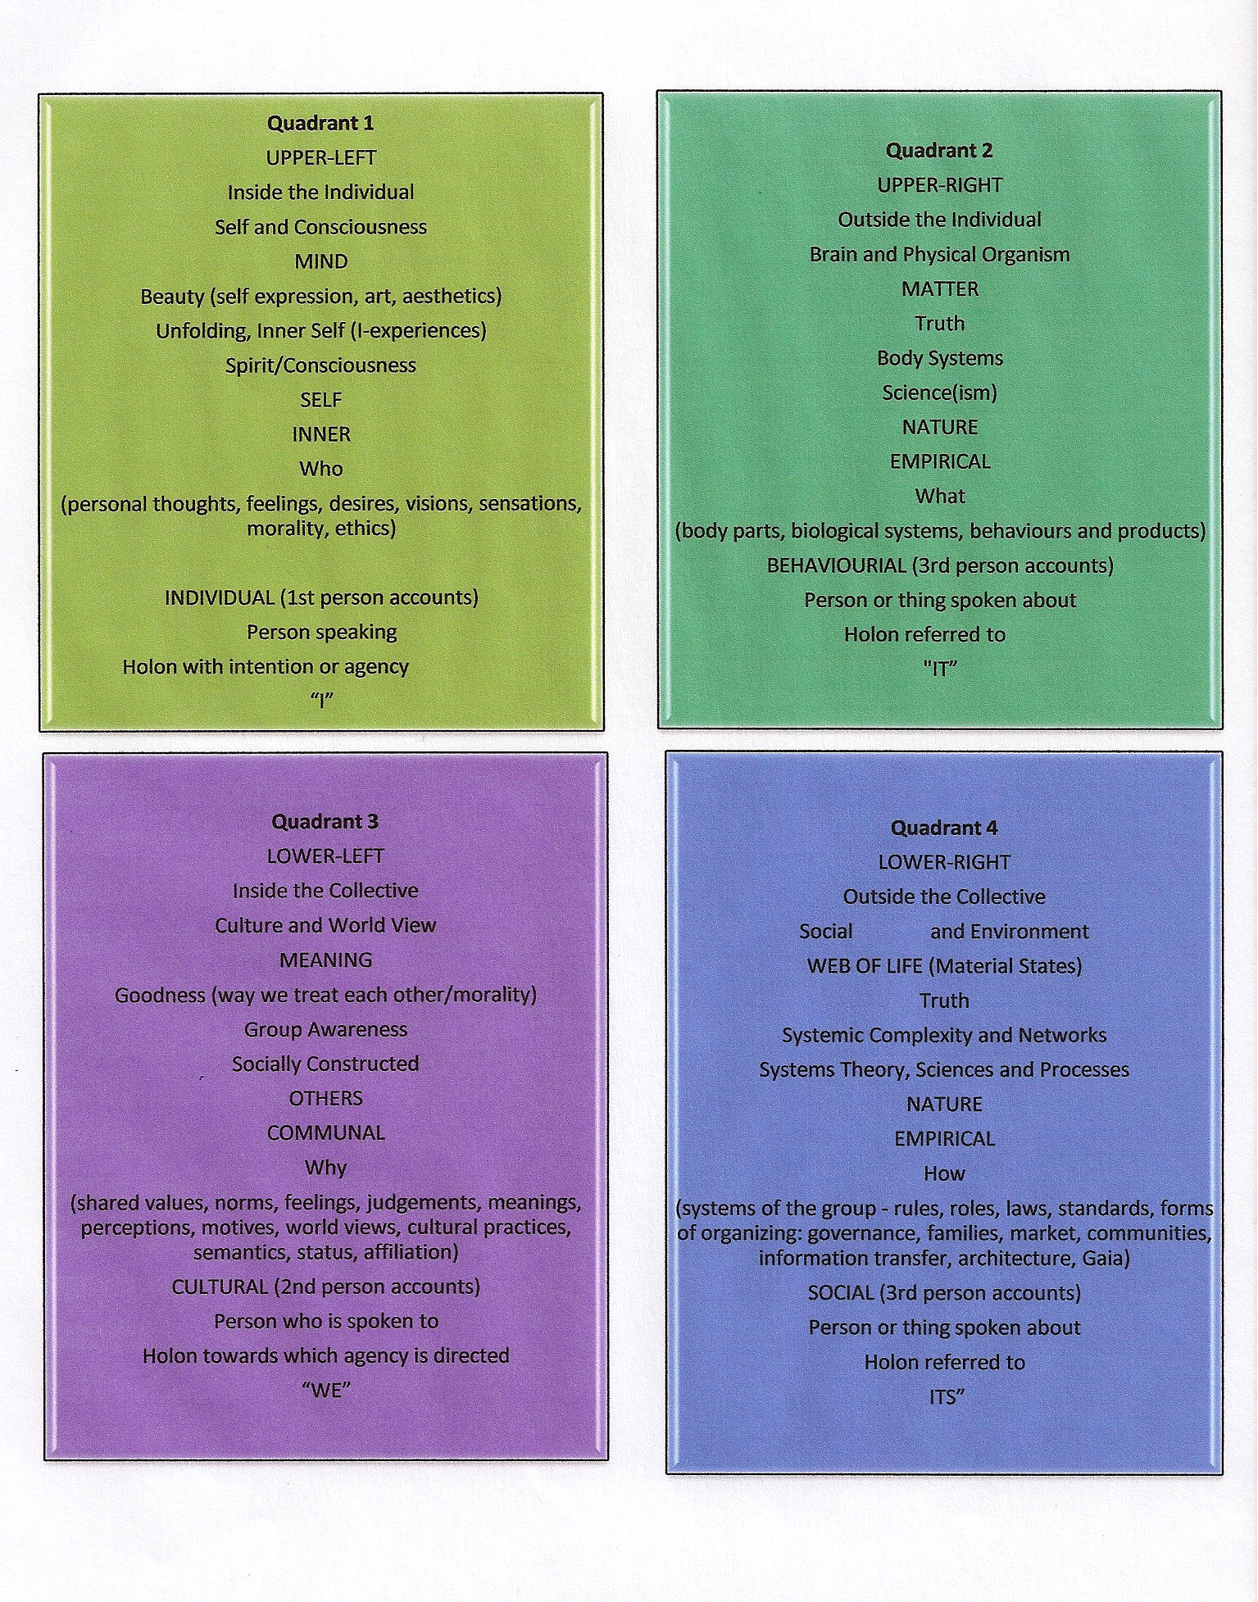


Slide 19
Lead in such a way that mind, matter, meaning and the web-of-life are all taken into account, or at least be aware that, when leading from one quadrant, the others exist.
Standing in one quadrant – leading from one quadrant – results in an imbalanced, flat, one-dimensional approach to life, living and leadership.
Leaving out any of these quadrants yields an incomplete picture of reality
Intent is strive for quadrant integration because no one guadrant is privileged – they are all needed to lead from an integral perspective.

Slide 20
Flatland extremism – standing on just one quadrant
Extreme idealism (Inner mind is reality)
Extreme scientism (outer matter is reality)
Extreme post-modernism (culturally construed meaning is reality)
Extreme systems thinking (web-of-life is reality)

Slide 21
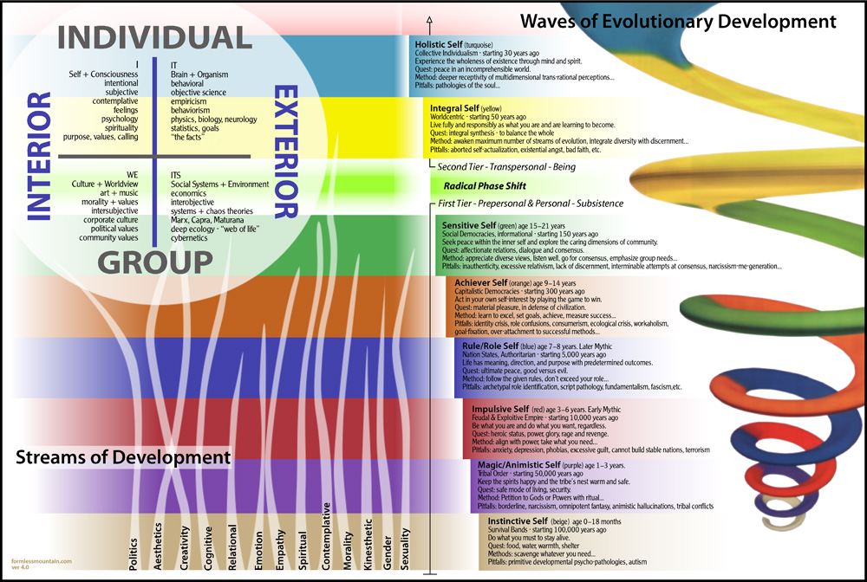

Slide 22

Final integral wisdom
An integral approach to leadership prevents people from seeing a heap of different elements (science, art, moral, religion) – leads to a poverty of vision
Helps them discern patterns that connect the elements into a whole – creating integral vision for integral leadership

Slide 23
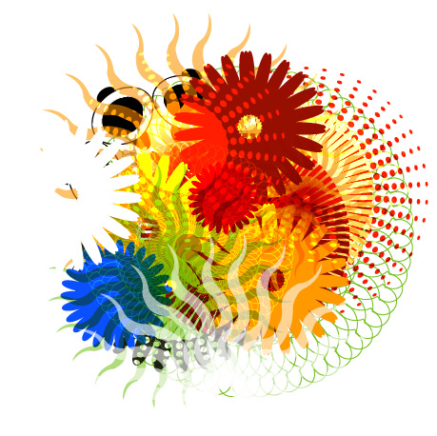
To reiterate....
There is no right or wrong. There is a place for everything.
MAJOR ISSUE is “how much complexity is needed to adequately understand the situation from a holistic, integral perspective, and then to lead accordingly?”

Slide 24
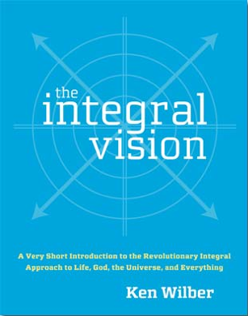
Integral Leadership

