Slide 1
Overview of Transdisciplinary methodology
Sue McGregor (Chair IDAC)
Prepared for Inaugural Inter-University PhD Program Students
July 2011

Slide 2

A reminder - Difference between methodology and method
Methodology
Method
a branch of knowledge that deals with the general principles or axioms of the generation of new knowledge
Generation/production of new data
Methods are the technical procedures and tasks undertaken to sample, collect and analyze data and report research results, informed by the methodology

Slide 3
Prevailing methodological approaches to conducting research include empirical, interpretive and critical (with reference to post-modernism, post structuralism, positivistic and post-positivistic, qualitative and quantitative)… .
To address the emergent, complex, wicked problems of the world, we need a new methodology to generate a new kind of knowledge:
What counts as knowledge (epistemology)
What counts as reality, feeling, existence (ontology)
What counts as logic
The role of values, norms and ethics (axiology)

Slide 4
Examples of TD problems faced by humanity (now being called “wicked” problems):
Unfulfilled human potential
Hindered freedom and injustices
Insecurity and lack of peace
Uneven distribution of resources
Uneven development
Human aggression and greed
Abuse of personal and political power
Disempowered citizens and communities
Unbalanced energy flows
Unsustainability

Slide 5
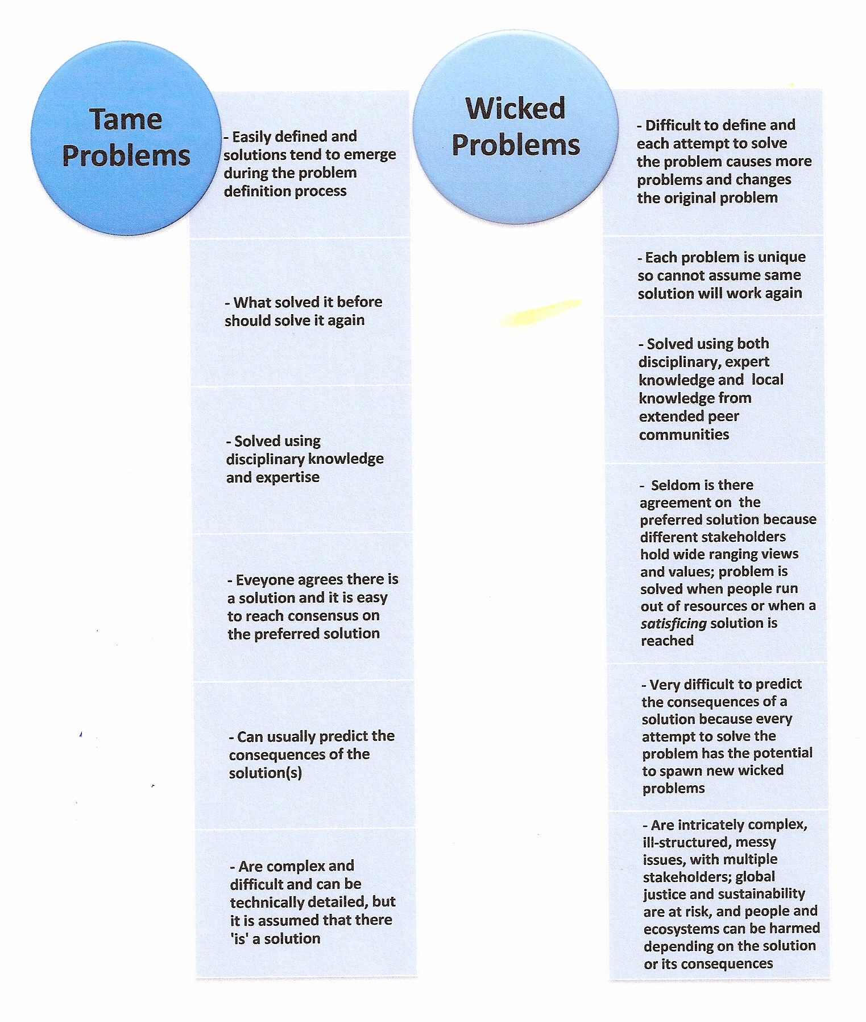
Wicked versus tame problems

Slide 6

TRANSDISCIPLINARY
KNOWLEDGE
‘Trans’ means zigzagging back and forth, moving across, going beyond, blurring boundaries, even pushing past boundaries. This is called INTELLECTUAL BORDER-WORK…. At the academy-civil society interface.

Slide 7
Multi- and - Interdisciplinarity are needed but are not enough
These approaches are confined within the university setting, the academy, and privilege only disciplinary knowledge.
They do not provide a space for minds prepared through other ways of knowing, the minds of those living with the complex problems and/or the minds which could contribute unique insights if only given a voice
There needs to be a meeting of the minds of those working within academic disciplines and those living life in civil society (NGOs, governments and businesses); this requires a new methodology.

Slide 8
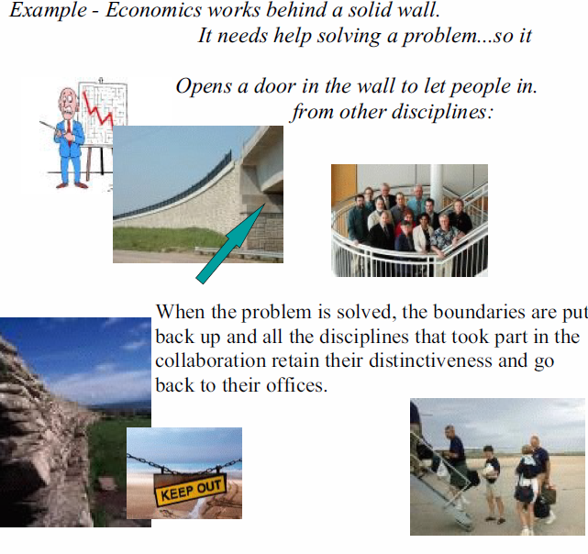
Multidisciplinarity

Slide 9
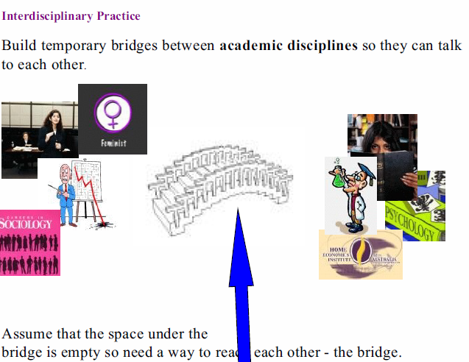

Slide 10
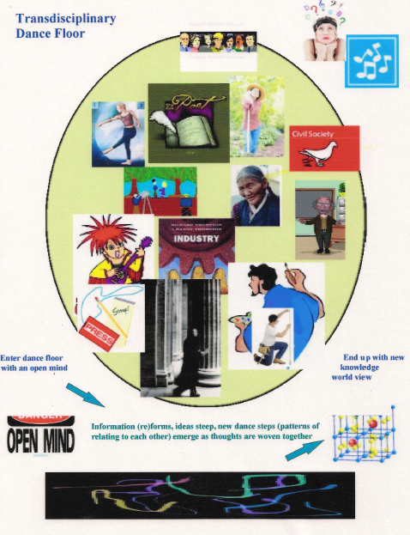

Slide 11
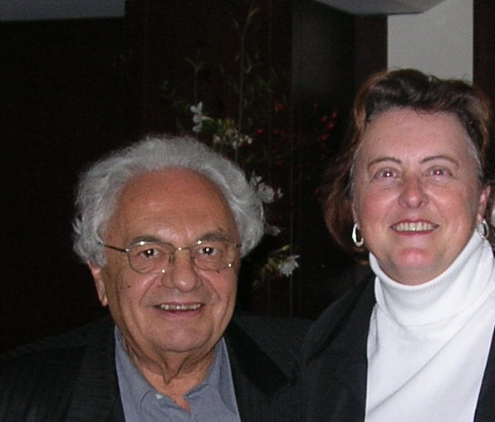
Professor Dr. Basarab Nicolescu

Slide 12
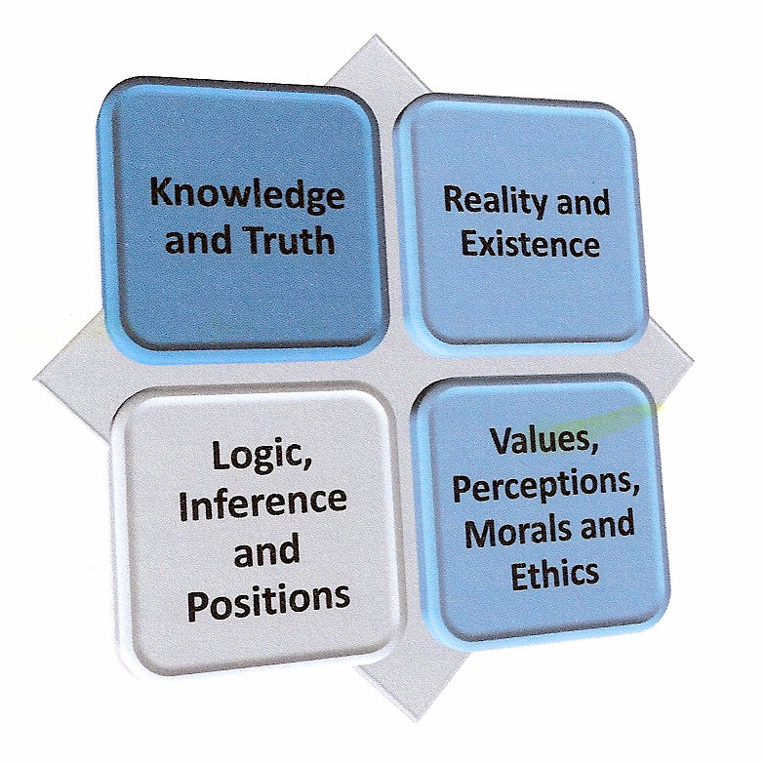
Four basic axioms

Slide 13
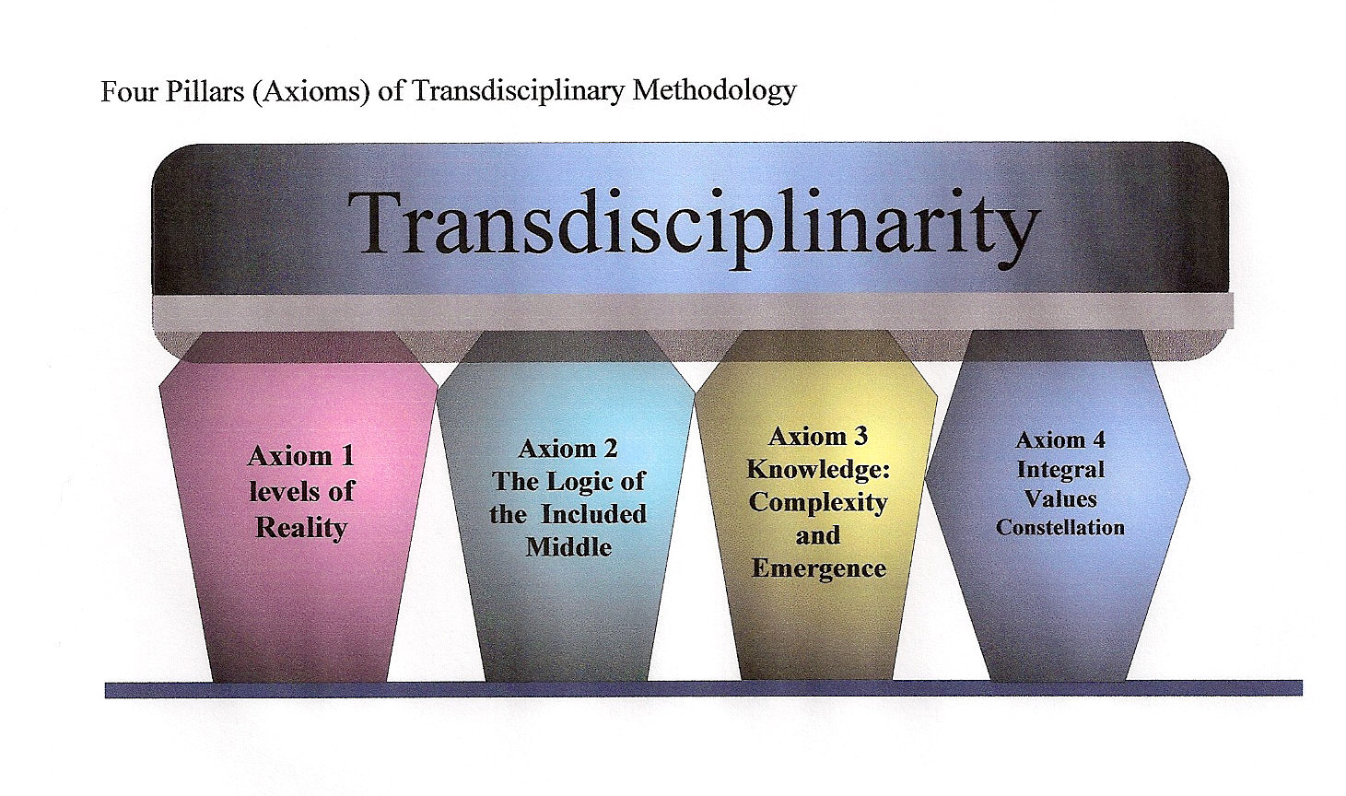

Slide 14
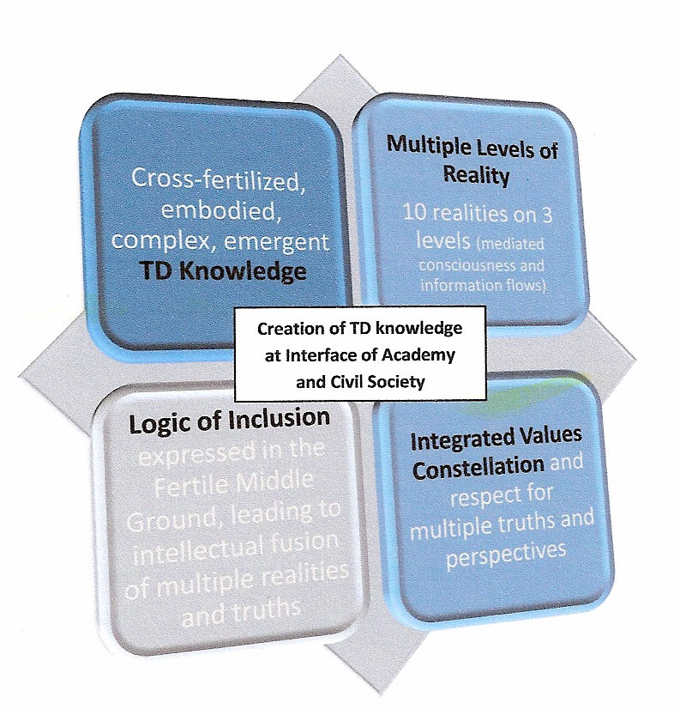
TD AXIOMS

Slide 15
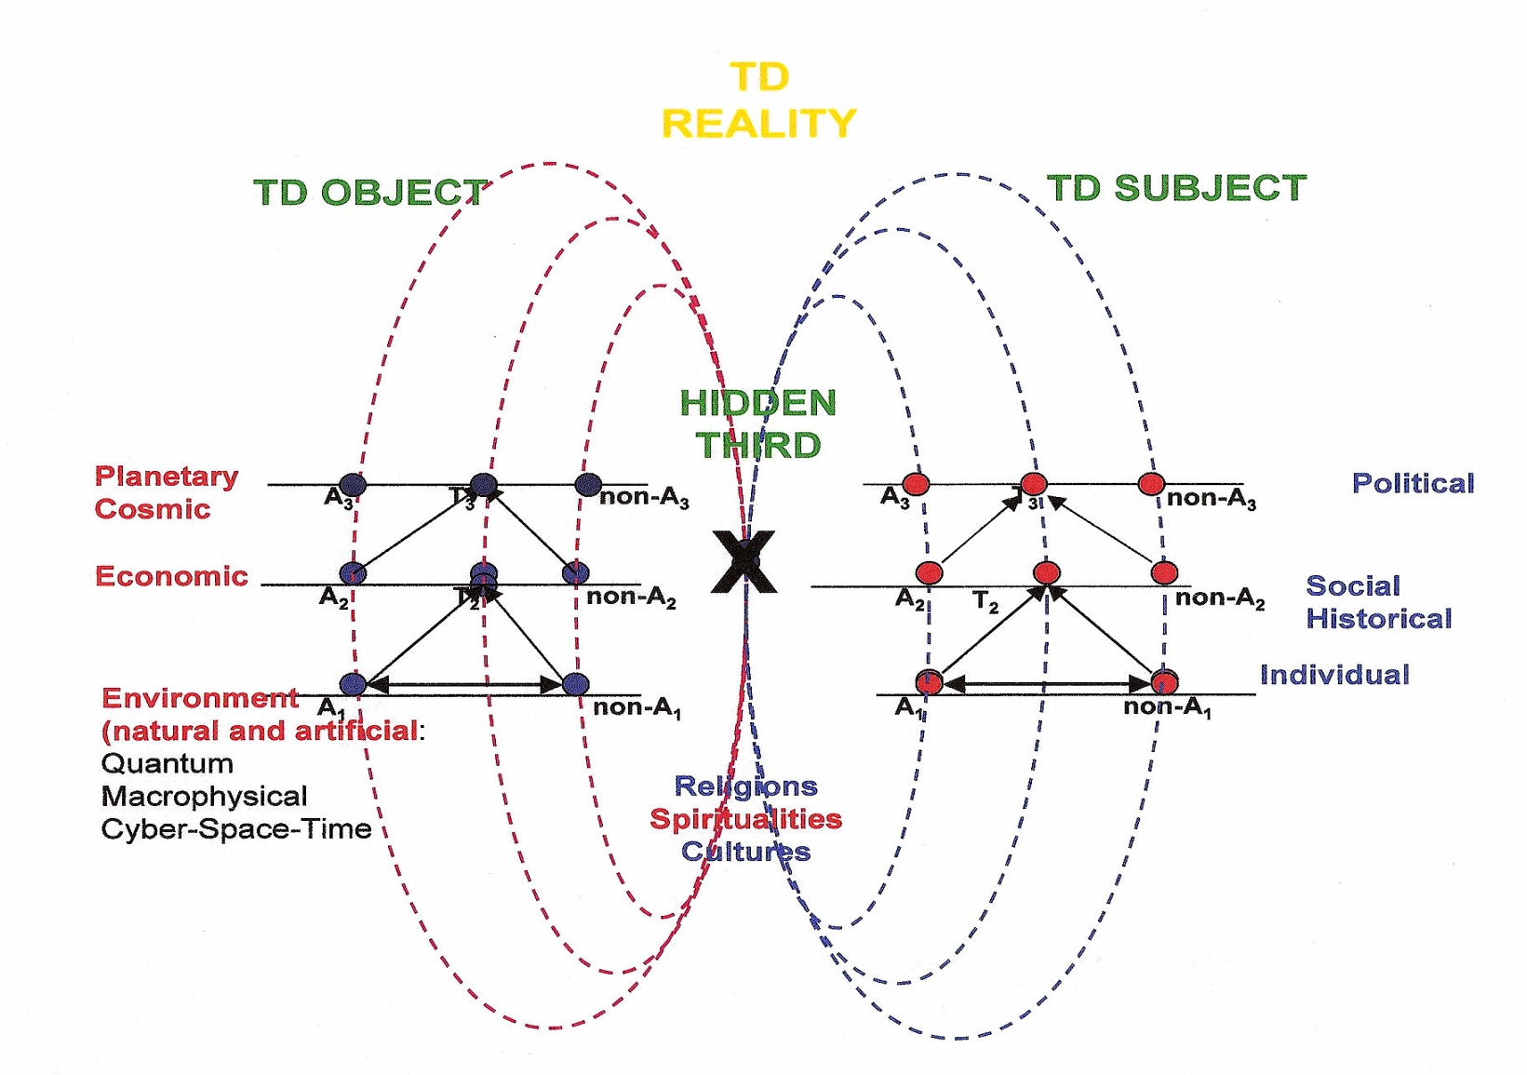
Axiom 1- ONTOLOGY multiple layers of reality and the hidden third
(Image used with permission of Basarab Nicolescu)
Axiom 1- Ontology
Multiple Levels of Reality

Slide 16
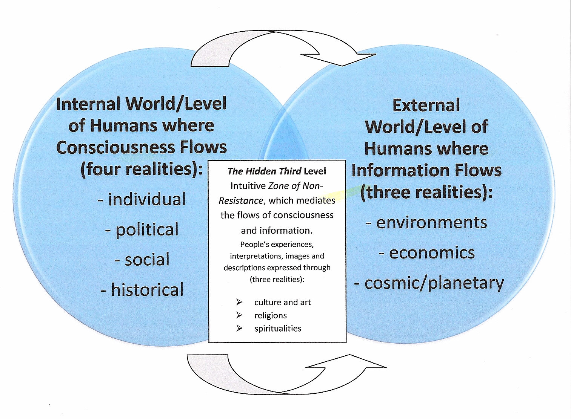
The Hidden Third

Slide 17
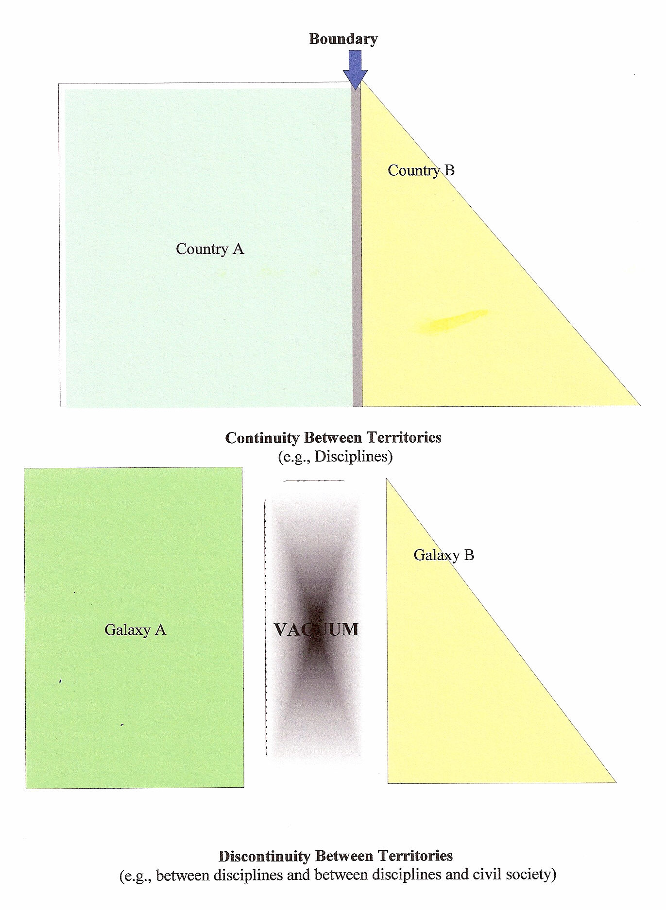
Where the hidden third operates – in the quantum Vacuum

Slide 18
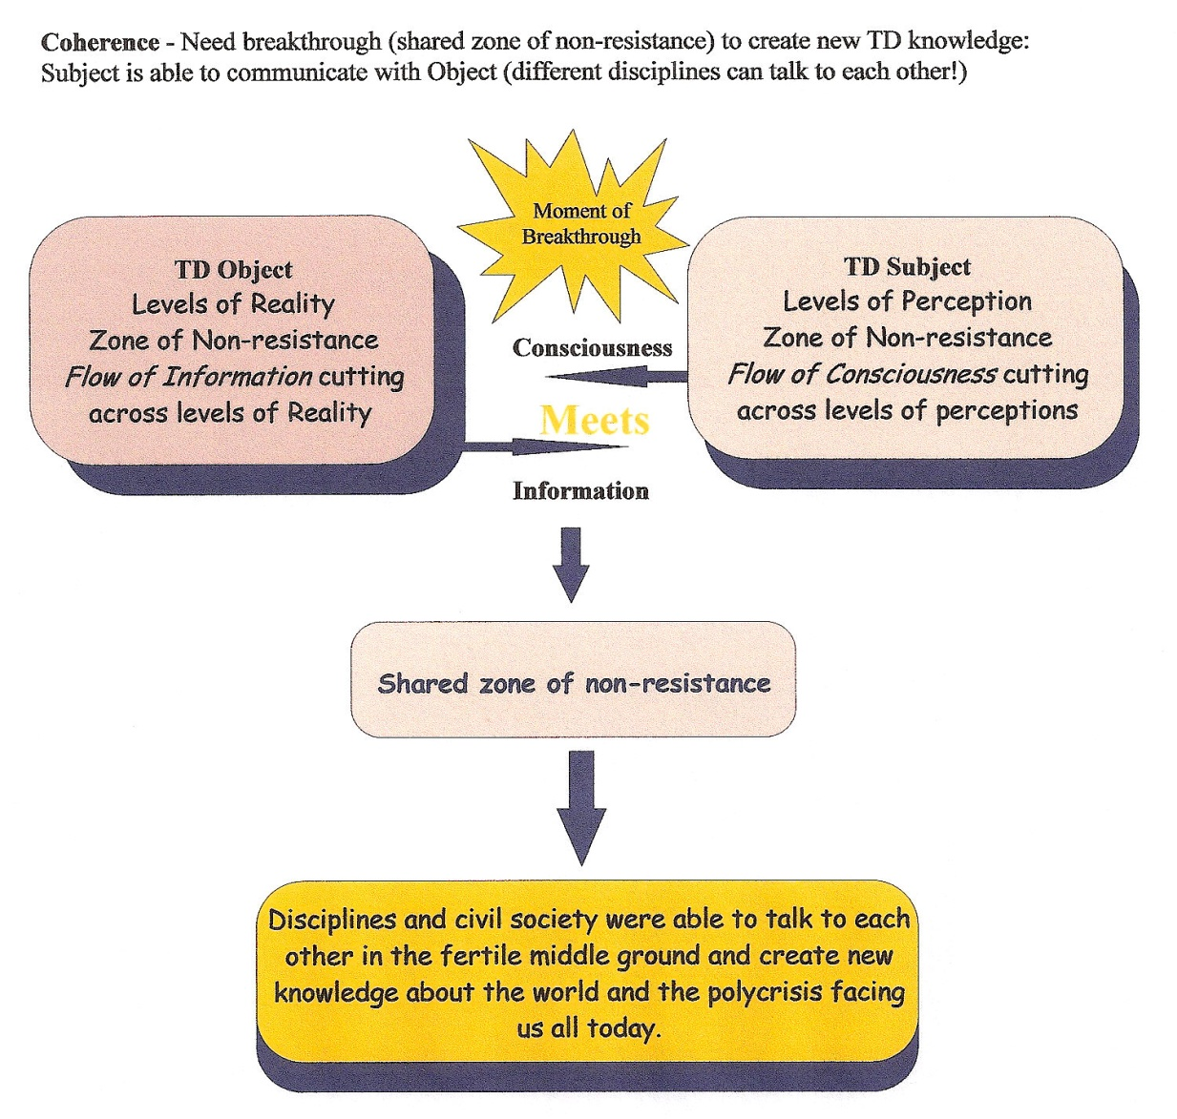
Meeting of the minds and consciousness

Slide 19
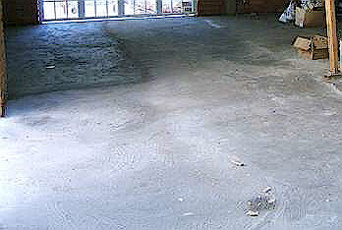
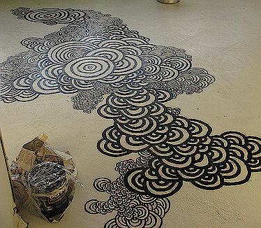
Axiom 2- LOGIC
Logic of the Included Middle (Right image)
This axiom is concerned with the habits of the mind that are acceptable to use to reason and make inferences (draw conclusions) when developing arguments, taking a position, interpreting data etc.
Left image – Logic of the Excluded Middle (dead empty space)

Slide 20

Newtonian Physics of the Excluded middle (dead empty static space)

Slide 21
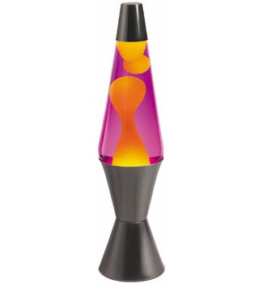
Axiom 2 LOGIC of the included middle con’t
I use the metaphor of the lava lamp. The space between the academy and civil
society is alive, dynamic,
in flux, always moving –
called the Fertile Middle Space
(the floor of the lava lamp).
There IS a middle ground!
INCLUSIVE LOGIC
Complex, emergent problem solving of wicked problems happens in the lava lamp.
Everything is in-formation (including information)

Slide 22
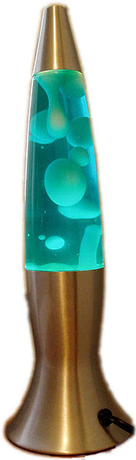
Entering the fertile ground of the included middle, crossing the zone of resistance to the fertile middle space

Slide 23

Axiom 3 – Knowledge
is emergent and complex
This is a different epistemology than that used in conventional science, which assumes that only knowledge that is generated using the scientific method is valid.
TD knowledge is created by integration and cross-fertilization of insights from the many levels of reality,
shared in the fertile middle
space using inclusive logic.
I call this form of TD knowledge
generation the dance. When
people bounce off each other,
energy is created –
INTELLECTUAL FUSION!

Slide 24
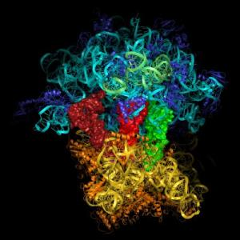
Axiom 3 knowledge Con’t
Remember those problems of humanity?
They cannot be solved by one discipline or one sector of society alone. They are too complex. TD deals with complex problems not complicated problems. Here’s an example. Poverty (resulting from uneven distribution of resources) is complicated because it is a knotted, tangled, detailed
intricate issue comprising security,
rights, responsibilities, justice
and freedom.

Slide 25
Axiom 3 knowledge Con’t
When the TD axiom of knowledge is applied, the assumption is that poverty ALSO is a complex problem, meaning it has the additional property of emergence. It is one thing to untangle a complicated problem and quite another to weave the strings that emerged into a new whole, to gain a better understanding of the world.
Emerge means to arise out of. What emerges? Novel qualities, properties, patterns, structures, relationships, in-formation and synergy… from the intellectual fusion. People were able to cross the hidden zone of resistance (the Hidden Third) between the multiple levels of realities and be open to other people’s world views and perspectives. There was a meeting of the minds, a flow of consciousness and of in-formation.

Slide 26

Axiom 3 knowledge Con’t
Engaging in TD knowledge generation by solving complex, wicked problems also assumes the issue is constantly changing as are the different people and their ideas (old and new) as they interact while untangling the knots and bringing new perspectives. Original perceptions about the problem (e.g., poverty) are left behind as a new fabric or weave takes place. EVERYTHING is in flux in the fertile middle space as people use inclusive logic to weave together insights from multiple levels of reality and differing perspectives and value premises. Have to respect new notions of order and chaos (see next)

Slide 27

Axiom 3 knowledge Con’t
The TD methodology of creating knowledge assumes that chaos is a necessary place for people to live because order comes from chaos. New insights appear in this chaotic state – in this vacuum. Also, people are self-organizing – they are capable of creating an inner core from which they gain stability as a world citizen.
People no longer feel compelled to maintain the status quo. New respect for emergent tensions instead of trying to keep things in balance.
Order Emerging from Within Chaos

Slide 28


Axiom 3 knowledge (Fini)
The TD knowledge necessary to solve the complex, emergent, wicked problems of humanity is ALIVE because the problems the knowledge addresses are alive, emerging from our life world. The knowledge created together (in the lava lamp) becomes part of everyone involved because once it is created, it falls back down on everyone
in the TD dance and becomes part of them:
Embodied knowledge!!

Slide 29
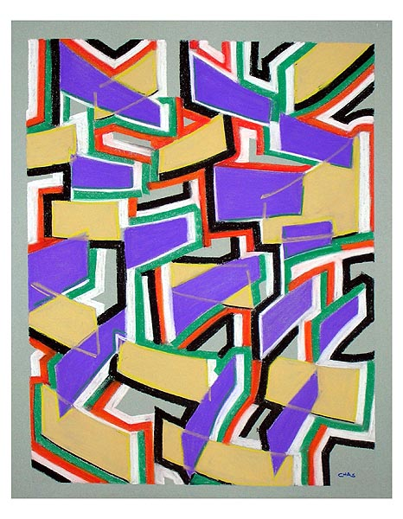
Axiom 4 Axiology:
Integral Values Constellation
The world is facing a polycrisis, a situation where there is no one, single big problem - only a series of overlapping, interconnected, complex, emergent and wicked problems.
This complexity infers the need for more than a single expert’s solution (it warrants multiple levels of reality, points of view, ways of knowing, diverse logics).
Interactions amongst multiple actors, as they problem solve a polycrisis, will give rise to value conflicts and contradictions. Whether the power people generate as they work together in the fertile middle space using inclusive logic to solve complex, emergent problems is negative or positive depends upon the nature of the TD relationships.
That, in turn, is predicated on values.

Slide 30
Axiom 4 integral values constellation
in order to develop necessary tolerance of different viewpoints so we can stay engaged in conversations about the complex, wicked problems shaping the human condition, we have to respect, manage and lead values
values are often the missing link in providing strategic solutions to key, global issues that are informed by a collage of differing worldviews held by individuals, cultures, nations and regional and international groups.

Slide 31

Values integration
The transdisciplinary dialogue, by its very nature, will witness the inescapable value loading of every inference and every opinion. Every line of conversation will face a potential clash of values, ethics and morals.
Problem solvers especially need to reconcile the different sorts of knowledge characteristic of the disciplines in the academy with the involvement of civil society/citizens.

Slide 32
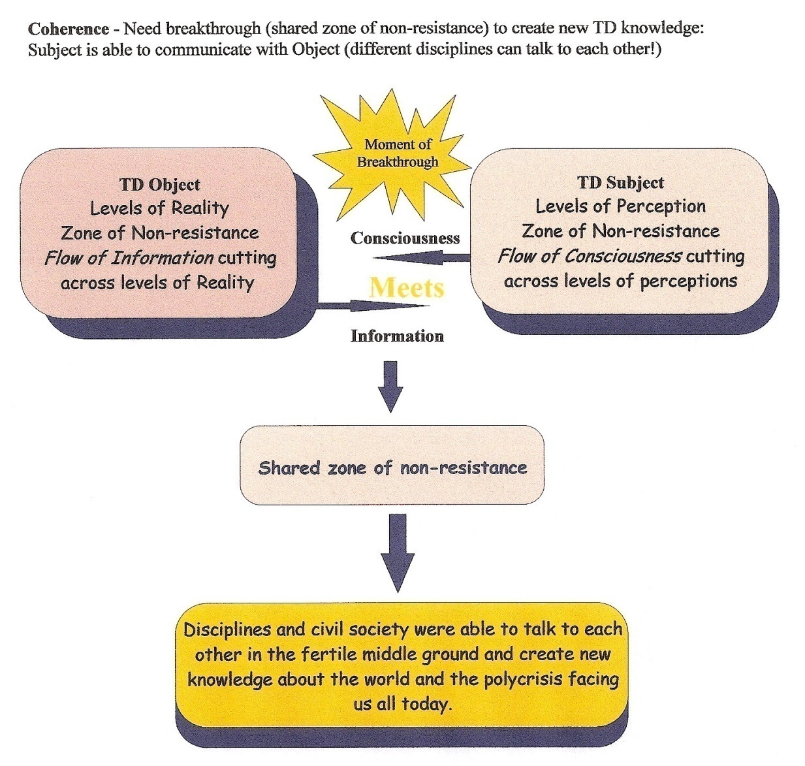
Axiom 4 integral values constellations in order to problem solve (also axiom 1, levels of reality – the meeting of the minds)

Slide 33
I Invite you to remain open to this new approach to conducting educational research around the pressing problems facing humanity

Slide 34
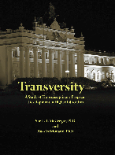
updates
July 2011 book entitled Transversity released
Article in press at Integral Leadership Review, challenging Nicolescu’s notion that we don’t need a TD axiology
March 2011 article explaining TD ontology in more detail, at Integral Leadership Review, http://integralleadershipreview.com/2011/03/demystifying-transdisciplinary-ontology-multiple-levels-of-reality-and-the-hidden-third/

