Slide 1

Sue L. T. McGregor PhD, IPHE, Professor Emerita (MSVU)
Nova Scotia, Canada
www.consultmcgregor.com

Slide 2
Invited Keynote for the Philippines’ Centennial Celebration (ZOOM) The Role of Home Economics in Rebuilding Filipino Families and Communities in the Next Century
Dr. Sue L. T. McGregor
Nova Scotia Canada
www.consultmcgregor.com

Slide 3
Verb play
The conference theme is “Redesigning the material and relational aspects of life through home economics.”
The verb redesign highlights the perceived need for home economists to change the existing design by revising daily life in terms of its appearance, function, and content.
From that I inferred that redesigning (revising) aspects of daily life involves helping families and communities
examine, reconsider, and improve both the
material (physical, economic, and technological) and
relational (emotional and social) aspects of their lives

Slide 4
Verb play
My keynote topic was “The Role of Home Economics in Rebuilding Filipino Families and Communities in the Next Century”
I assumed the verb rebuild means reinforcing or strengthening families
It could also mean helping them revert to a previous condition by reorganizing, restoring, or reshaping themselves after they were challenged and compromised

Slide 5
Larger question…
Put simply, rebuild is a verb for actions that home economists might take to create rebuilt families and communities
Filipino home economists would take action, and Flipino families and communities would benefit. This assumption then begged the question:
“What happened to families and communities during the last century that they must be rebuilt in the next century?”

Slide 6
Profile of Filipino Families
Female (62%)/male (39%)
Matriarchal society
Catholic
Malay descent (but other ancestry as well)
Ethic diversity (four main groups)
Gross national income per capita $3,430 US
Nuclear family and large extended family/kin
Married children live with parents
Large and young population, which is growing
Rural families average three children/urban fewer children

Slide 7
Profile of Filipino families
Divorce is not legal (unless married to a foreigner…)
Pregnant girls often marry before child is born
Increase in remaining single
47% urban and 52% rural but increased urbanization
Significant number of urban residents live in poverty (lack water, electricity, and sanitation)
Their impermanent houses are from scavenged materials
Rural families live in more permanent two-room buildings elevated on piles
Costal families are connected over the water with a network of elevated pathways

Slide 8
Profile of Filipino families (fini)
High incidence of family members working abroad or overseas
They send money and care packages (Padala boxes) home to support their family and kin
Family needs are prioritized over individual’s needs
Guided by filial piety (care and respect for parents and elders) to avoid hiya (shame and embarrassment), and losing face
Characterized as family centrism and family expectations – identity and future life revolve around family’s needs – pamilya muna (family first)

Slide 9
Grace M. Mabasa’s thoughts on challenges and threats to Filipino families (2012)

Slide 10
She coined the acronyms
D-SPEARS to reflect the major issues threatening the safety, health, well-being, and future of Filipino families
OVERCOMES to mitigate the negative impact of D-SPEARS

Slide 11
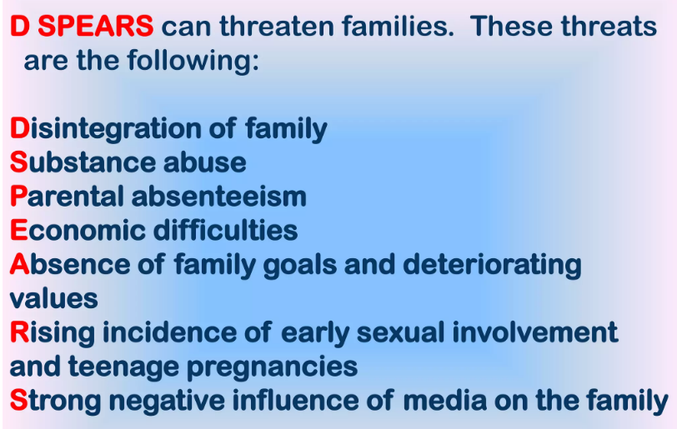

Slide 12
Fallout of D-SPEARS (Mabasa, 2012)
parent’s inability to provide social control within the family unit
fewer opportunities for a cohesive family unit with solidarity (especially when one or both parents is working abroad and sending money home)
economic difficulties force children to leave school and go to work
both parents working exposes children to street hazards because no one is home when school ends

Slide 13
Fallout of D-SPEARS (Mabasa, 2012 fini)
parents’ inability to recognize and inculcate in their children a higher meaning of and purpose for the family unit leads to a loss of family goals and the deterioration of family values, which provide anchors in hard times. The absence of family values (i.e., valuing the family) thus creates susceptible weak spots in the family unit.
an excessive, inadequately monitored media presence compromises already-strains interpersonal relationships and family ties.
teens’ early sexual involvement exposes them to sexually transmitted diseases, pregnancies, too-early marriages, emotional wounds, and wasted lives; the whole family is affected

Slide 14
OVERCOMES: we can help families
O have open and honest communication
V employ zero tolerance for violence or any form of abuse and
E become empowered (i.e., find their inner power and strength)
R strengthen relationships among their members
C develop communication, decision-making, and problem-solving skills
O value and ensure there are regular family outings and get-togethers
M teach parents how to monitor their children’s media exposure
E teach adults about career planning and gaining employment so economic benefits can be realized for improved family welfare
S appreciate the importance of nurturing spirituality to offset their heavy reliance on materialism and consumerism

Slide 15
Tailor Practice to the Context
This comprehensive roster of OVERCOMES actions to address D-SPEARS deals with both material and relational aspects of daily life – things that can be concretely targeted when rebuilding families.
But context also matters. Home economists working in different regions of the Philippines will need different technical knowledge and expertise:
Many urban dwellers tend to lack water, sanitation, electricity, and permanent shelters.
Rural dwellers have shelters but their living accommodations are crowded, and they face issues while living off the land (agricultural employment and subsistence farming)
Coastal dwellers face quality of life challenges inherent with living and working on the water

Slide 16
Actions Home Economists Can Take to Rebuild Filipino Families … Beyond OVERCOMES

Slide 17
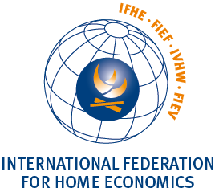
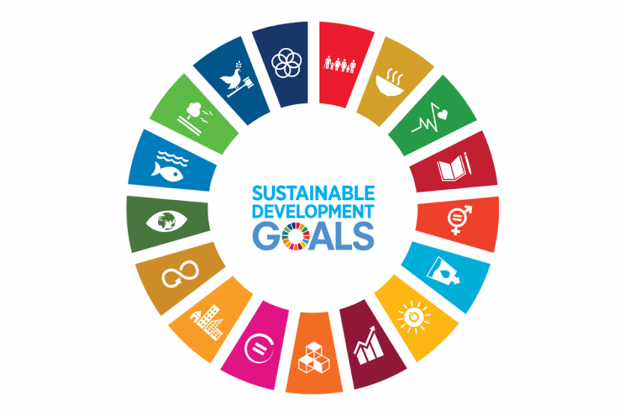

Slide 18
IFHE’s (2008) Home Economics Practice Dimensions
IFHE's Four Dimensions of Home Economics Practice
ACADEMIC DISCIPLINE
- educate new scholars
- conduct research
- create new knowledge
- create new ways of thinking for professionals and for society
EVERYDAY LIVING ARENA
- focus on developing human growth and potential in households, families, and communities
- help individuals and families meet human necessities and basic needs
SOCIETAL ARENA
- influence and develop policy
- advocate for individual, familial, and community well-being and empowerment
- utilize transformative practices
- facilitate sustainable futures
CURRICULUM AREA
- help students discover and further develop their resources and capabilities
- use above to direct students' professional decisions and actions
- prepare students for life in general by clarifying and honing their capabilities

Slide 19
ALL Filipino home economists have a role to play in rebuilding Filipino families and communities:
IFHE’s framing of the profession along four dimensions affirms that Filipino home economists striving to rebuild families and communities can exercise their influence and expertise in
research
education (all levels) and curricula
the policy arena (all levels of government)
civil society and non-governmental organizations
non-profit organizations
development agencies
employees or consultants to industry
their own entrepreneurial initiatives

Slide 20
A different way to think about why families should be rebuilt
Strong families are the bedrock of a supportive human condition ,and home economists work to keep families strong … not just so each Filipino family is OK, but so the human family is OK.
To do that, we work through families (as well as for and with families)
View families as a means to an end with that end being an improved human condition
Each Filipino family belongs to the human family.
Hence, home economics should consider a focus on the home for the good of humanity and the human condition (which is very strained right now)
A strong human condition supports and sustains families, but strong families are needed if we want to ensure and perpetuate a supportive human condition (a matrix of prosperity, sustainability, peace, justice, freedom, solidarity, stability, hope)

Slide 21
Four more ways to rebuild Filipino families and communities:

Slide 22
1st Contribute to National Development
National development focuses on improving “the economy, entrepreneurship and opportunity, governance, education, health, safety and security, personal freedom, and social capital” (Global Sherpa, 2012, para. 10).

Slide 23
Contribute to National development
Strong Filipino individuals, families, and communities bode well for national development in the Philippines, but right now many elements pursuant to the material and relational aspects of daily life are in jeopardy:
poverty alleviation
accessible housing
employment opportunities
successful education
healthy family and social dynamics
and so on

Slide 24
Renowned Philippine home economist, Florenda Gabriel, said:
“Home economics does not by itself produce the desirable changes necessary for national development to occur” (1998, p. 4).
Instead, “the primary change agent is the government which sets the national direction and strategies for development” (p. 7).
Home economists act as a bridge and catalyst between families and governments by translating “macro-level policies to micro-level implementation” (p. 7).
Because home economists diligently work for and with individuals and families and gather “baseline data” about their circumstances and human condition, they are “ideal persons to draft programs of action [that can feed into national development plans]” (p. 7).

Slide 25
2nd Be Philosophically Aware
To successfully rebuild Filipino families and communities in the next century, home economists must sustain themselves (maybe rebuild themselves) by being fully aware of their belief system, which informs and guides their practice – become philosophically savvy
I encourage a national conversation about “What is the philosophical cornerstone of Filipino home economics?”

Slide 26
To illustrate…
North American home economists focus on well-being, quality of life, and standard of living as interpreted through critical science and reflective leadership.
Scandinavians are concerned with everyday life, competent, thoughtful practice, and being integral specialists.
Baltic home economists care deeply for the humanistic aspects of daily life.
Japanese home economists strive for the restoration of humanity via human protection and the home as habitation (place of existential hope).
Australia is guided by being an expert novice, viewing home economics at a convergent moment, and future proofing the profession.

Slide 27
3rd IFHE’s focus on six SDGs
IFHE maintains that home economists bring a unique approach to achieving six specific SDGs whose attainment would help rebuild and strengthen Filipino families:
poverty
hunger
health and well-being
gender equality
clean water and sanitation, and
responsible consumption and production

Slide 28
Home economists…
interpret daily life from an interdisciplinary, integrative, holistic, and relational perspective.
They thus view each goal as an inherent part of a complex collection of problems – the SDGs do not stand in isolation and cannot be solved in isolation. To illustrate, I think Filipino home economists can readily appreciate that
dealing with poverty requires attention to hunger.
Ensuring food security requires gender equality.
Good health and well-being are tied to responsible consumption and production.
Clean water and sanitation are intricately tied to poverty eradication, good health, and so on.

Slide 29
Gain authority and legitimacy
The SDGs cannot be achieved by focusing on one goal at a time. Our integrative mindset readily accepts this imperative.
Filipino home economists are encouraged to acknowledge, employ, and message this aspect of their approach to the achieving SDGs. This strategy will lend legitimacy and authority to their voices around any rebuilding efforts related to SDGs impacting Filipino families and communities.

Slide 30
4th action beyond OVERCOMES
Claim CHE’s competitive advantage in
community nutrition
food technology
family life and child development
hotel, restaurant, and institution management
clothing technology
interior design; and
general home economics education

Slide 31
Competitive Advantage
At the crux of a competitive advantage is the assumption that someone is in competition with others via striving for superiority or defeating them (win/lose mentality).
Having a competitive advantage (i.e., favourable position to gain benefits) simply means someone is able to contribute or do something more efficiently than a rival.
Capitalizing on this advantage lets someone outperform or overcome their competitors
They gain the advantage and can exercise influence and power.

Slide 32
With a twist…
I maintain that home economists do not work in their own self-interest. They are concerned instead with the interest and welfare of individuals, families, and communities
Interdisciplinary, integrative, and holistic home economics thinkers, who specialize in content about issues faced by Filipino citizens, definitely have a competitive advantage in the political, economic, and social arenas.

Slide 33
CHE’s Advantage!
To everyone’s benefit, home economists have an edge over others who are narrow, linear thinkers and narrowly specialized, or held hostage by their self-interest.
In addition to subject matter expertise, home economists holistically see connections and find synergies that others easily miss – they can connect the dots.
Also, they critically reflect on a situation (discerning power dynamics) and strive to collaborate in reciprocal relationships with other stakeholders. Those involved tend to respect resultant solutions that inturn are more sustainable when implemented.

Slide 34
CHE Can Choose to Reframe
CHE-trained and professionally socialized home economists can choose to reframe and market themselves as having a competitive advantage that makes them legitimate players in the game.
Paradoxically, they can bolster their competitive advantage by working collaboratively with other stakeholders while rebuilding Filipino individuals, families, and communities – that is a key part of their competitive advantage aside from their technical expertise and professional mission.

Slide 35
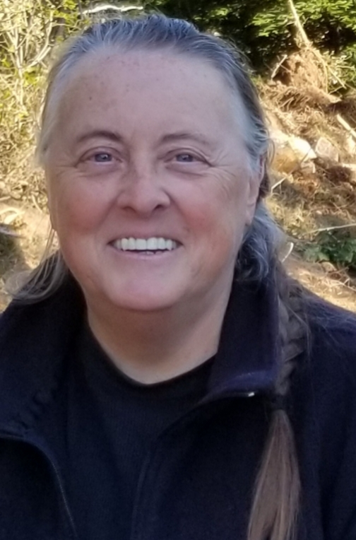
Wrap up
In closing, I am not the one to say what rebuilt Filipino families and communities might look like.
Nor should my thoughts constitute the final words on how Filipino home economists should move forward.
That said, I do feel comfortable, as one home economist speaking to another, suggesting that you should look inward and outward to discern the dynamics of your current context.
Then you should approach your family and community rebuilding and redesigning enterprises from a contextually informed and philosophically aware stance.

Slide 36
Working for, with, and through families, Filipino home economists can collaboratively create a strategic blueprint for rebuilt families and communities scaffolded to take on the next century. Thank you for this honour on your centennial celebration!

