Slide 1
Three Leading Approaches to Transdisciplinarity March 30 2023 Panel Discussion Cleveland State University Urban College
Sue L. T. McGregor PhD, IPHE, Professor Emerita (MSVU)
McGregor Consulting Group www.consultmcgregor.com

Slide 2
Disciplines
Each discipline in the academy has its own name and is involved in producing new knowledge for its knowledge base
NOTE producing knowledge entails a pre-determined process leading to validatable or trustworthy outcomes, while co-creating knowledge requires an imaginative, inventive process leading to something emerging for the first time
Disciplines are basically divided into arts and cultural studies, humanities, natural sciences, social sciences, formal sciences (e.g., computers, math), and applied/administrative sciences
https://en.wikipedia.org/wiki/Outline_of_academic_disciplines
Each discipline usually has its own journals, library holdings, learned societies, professional associations, academic departments within faculties, and funding streams.

Slide 3
Disciplinary work is all done within the academy
All three familiar word-forming elements refer to research and scholarship confined to the university setting:
mono means one discipline
multi means many disciplines
inter means between, among, in the midst of disciplines

Slide 4

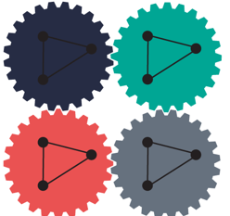

Disciplinarity
mono (intra) means one discipline in total isolation
multi means more than one discipline, but they do not intersect nor is there any intent to merge disciplinary knowledge – boundaries remain intact. Disciplines are adjacent (close to and nearby), but they only share respective knowledge, so people can extract what they want/need for their own disciplinary work
inter means coordinated and reciprocal collaboration and integration between or among teams of disciplines, but there is no intent to dismantle disciplinary boundaries just bridge them, so people can work together

Slide 5
Truncated transdisciplinarity
Trans means to cross, over, beyond, through, and zig-zag
Many people narrowly understand transdisciplinarity to be interdisciplinarity with the intent to create new and novel theories, methods, conceptualizations, or approaches that transcend (move beyond) the individual disciplines involved in interdisciplinary team work.
This is a form of hyper or hybrid interdisciplinarity because it is still inside the academy.
While respecting this understanding and practice, my talk today presents a different approach, wherein ‘the beyond’ (trans) is literally beyond university disciplines to involve others outside the academy.

Slide 6
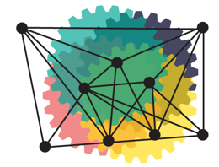
Transdisciplinarity thus means
knowledge co-creation* that is at the same time between, among, through, and beyond academic disciplines and includes government, industry, and civil society.
Civil society includes conventional higher education institutions (mono, multi, and interdisciplinary), individuals, families, communities, and any nongovernmental organizations and institutions advocating their interest.

Slide 7
The 3 prominent TD approaches each conceptualize ‘the beyond’ differently
Basarab Nicolescu’s new methodology for co-creating complex, embedded, embodied, and cross-fertilized knowledge with actors beyond the academy (disciplines are not enough anymore)
Zurich’s science-technology-society triad – a new way for science to work with society (but science still reigns) to co-create socially robust, socially accountable, and socially distributed knowledge in context
Brazilian HPTD-M – a new way for public administration/ public policy to create applied knowledge using the holopraxis: a study of the actions (praxis) of the whole

Slide 8


Slide 9
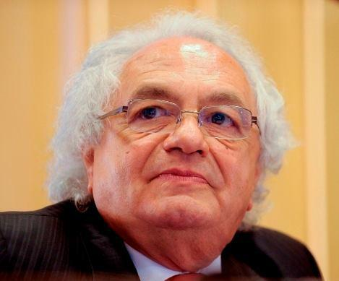
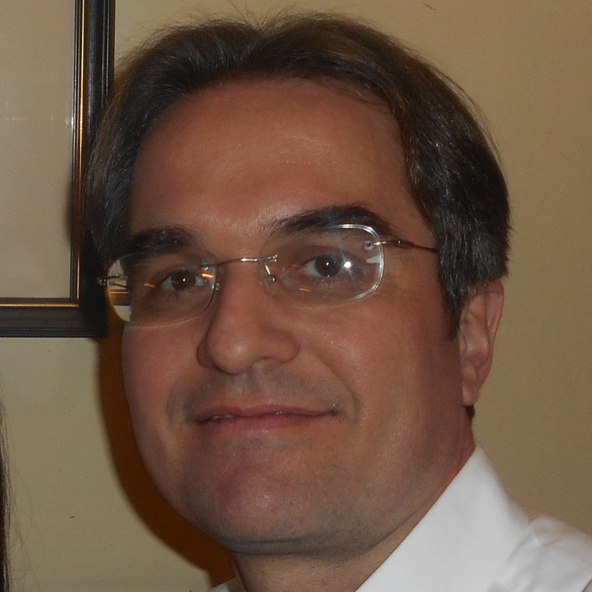
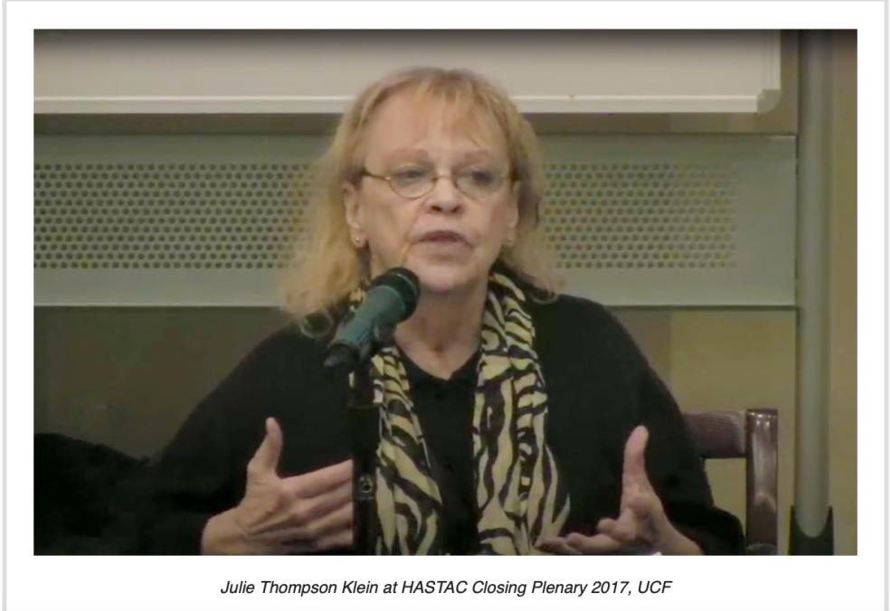

Slide 10
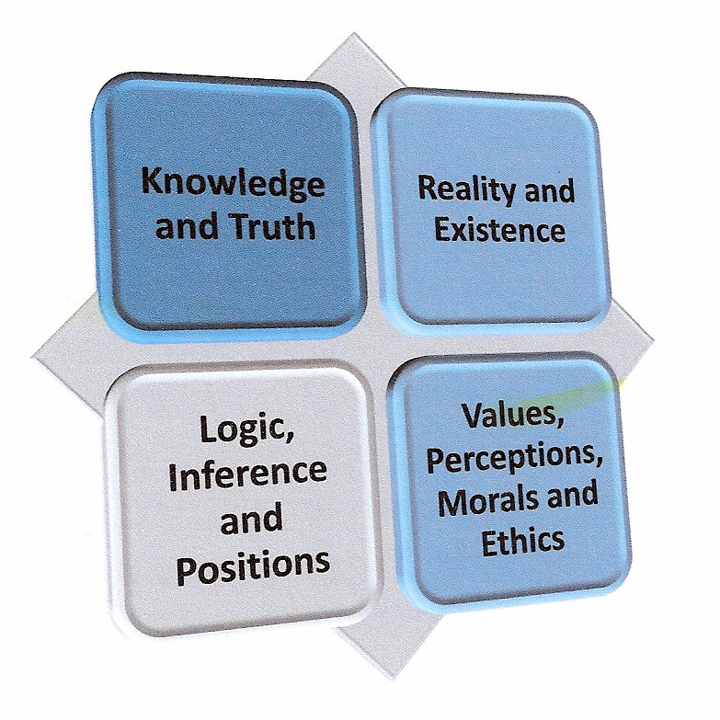


Method refers to tasks for conducting research. Methodology refers to the philosophical underpinnings of the research – AXIOMS – people hold taken-for-granted assumptions about what constitutes:

Slide 11
Three dominant methodologies for producing knowledge
Empirical assumes there is one level of reality; the one truth (objective knowledge) is out there waiting to be discovered using the scientific method and exclusive and deductive logic. Value neutral.
Interpretive (humanistic) assumes reality is in people’s minds; there are multiple truths that are dependent on how people interpret their world (perspective seeking). Knowledge is subjectively constructed by people using inductive logic (specific to general). Value laden.
Critical (power) assumes reality is shaped by power relations. Truth is contextual. Knowledge arises from critically questioning historical, social, and political practices that cause oppression, marginalization, and exploitation. Inductive logic; value driven.

Slide 12
Nicolescu formulated a fourth, TD methodology for co-creating knowledge based in quantum physics and complexity science
Nicolescu's TD Methodological Axioms
Ontology (Reality):
Multiple levels of Reality (subjective internal and objective external); movement among and beyond these levels, in the zone of nonresistance to contradictory ideas, is mediated by the lubricating, mind-opening Hidden Third
Epistemology (Knowledge and Knowing):
Cross-fertilized, embodied, emergent, and complex co-created knowledge
Axiology (Values):
Individuals’ personal value sets are eventually temporarily replaced with a set of transdisciplinary values engendered in collaboration and conducive to keeping the work moving forward
Logic:
Reasoning and argumentation are grounded in inclusive logic (accommodates contradictions) and complexity logic (interweave new strands of thought into something complex and owned by everyone)

Slide 13
Multi-levelled Reality structure
TD-SUBJECT
Internal Level of Reality
Internal contextual world of humans where subjective perspectives and consciousness flow
individual (psychological and philosophical)
HIDDEN THIRD and ZONE OF NONRESISTANCE
Mediating force lubricating the movement (flow) between internal and external Realities in a zone where people remain open to each other
Religions, and faith
TD-OBJECT
External Level of Reality
External world of humans where objective information flows
economics (includes business and law)
political (includes ideological)
planetary (planet, global, worldwide)
Spirituality (inward searching), and the Sacred (connection to Earth)
Culture, and the Arts (drama, theatre, music)
environment (and ecology)
cosmic (universe and mulitiverse)
technology (includes science and medicine)
family and kinship
geographical (local, national, regional)
historical
social, collective (community)
These are not Realities; instead, they cross all levels of Reality acting as spirit-opening, mind-opening unifying modalities leading to a new trans-Reality for this particular context

Slide 14
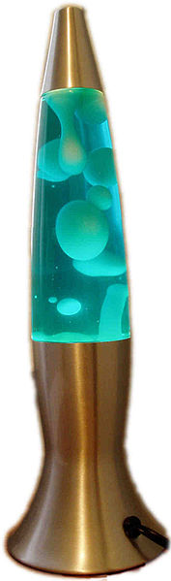
People from many levels of Reality enter (or not) the fertile ground of the included middle, crossing into the zone of nonresistance, to co-create cross-fertilized, emergent, and embodied TD knowledge using inclusive logic and the logic of complexity with movement and interactions lubricated by the Hidden Third. A set of TD values specific this initiative also emerges.

Slide 15
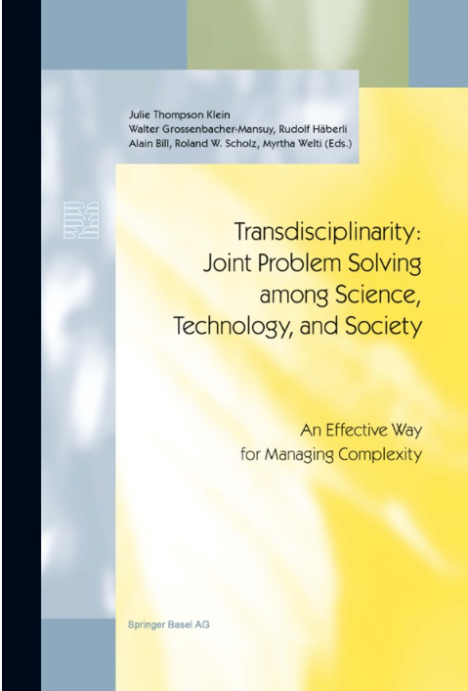
ZURICH TD Approach (2000 conference)

Slide 16
Joint problem solving among science, technology, and society: a new way to do science (academy and disciplines) -- this time with society (practice and practitioners, lay and professionals):
Contextuality Problem is context and locale-specific, thus knowledge is developed in 'the context of application'
Heterogeneity Diverse contexts and characters must be creatively used to produce knowledge
Mode 2 Knowledge Production:
Socially Robust knowledge
Socially Accountable knowledge, actors, and outcomes
Postnormal Science: beyond the normal scientific method:
New social-oriented role for science requires science to assume a different role in public policy:
- deal with uncertainty
- acknowledge high risk, high stakes, and urgency
- deal with complexity
- value the plurality of legitimate perspectives and their value loadings
- juggle and respect multiple stakeholders' interests, positions, and perspectives
Social Responsibility
Reflexive, immersed actors

Slide 17
Brazilian TD approach called Holopraxis Transdisciplinary Management (HPTD-M)
Inspired by the holopraxis construct
Holo means wholeness or whole
Praxis means action and practice (not just theorizing)
Holopraxis thus refers to creating knowledge by studying the actions (praxis) of the whole
This leads to a wholistic vision of knowledge.
Instead of simply knowing reality rationally, people would comprehensively understand reality in application (by using HPTD-M)

Slide 18
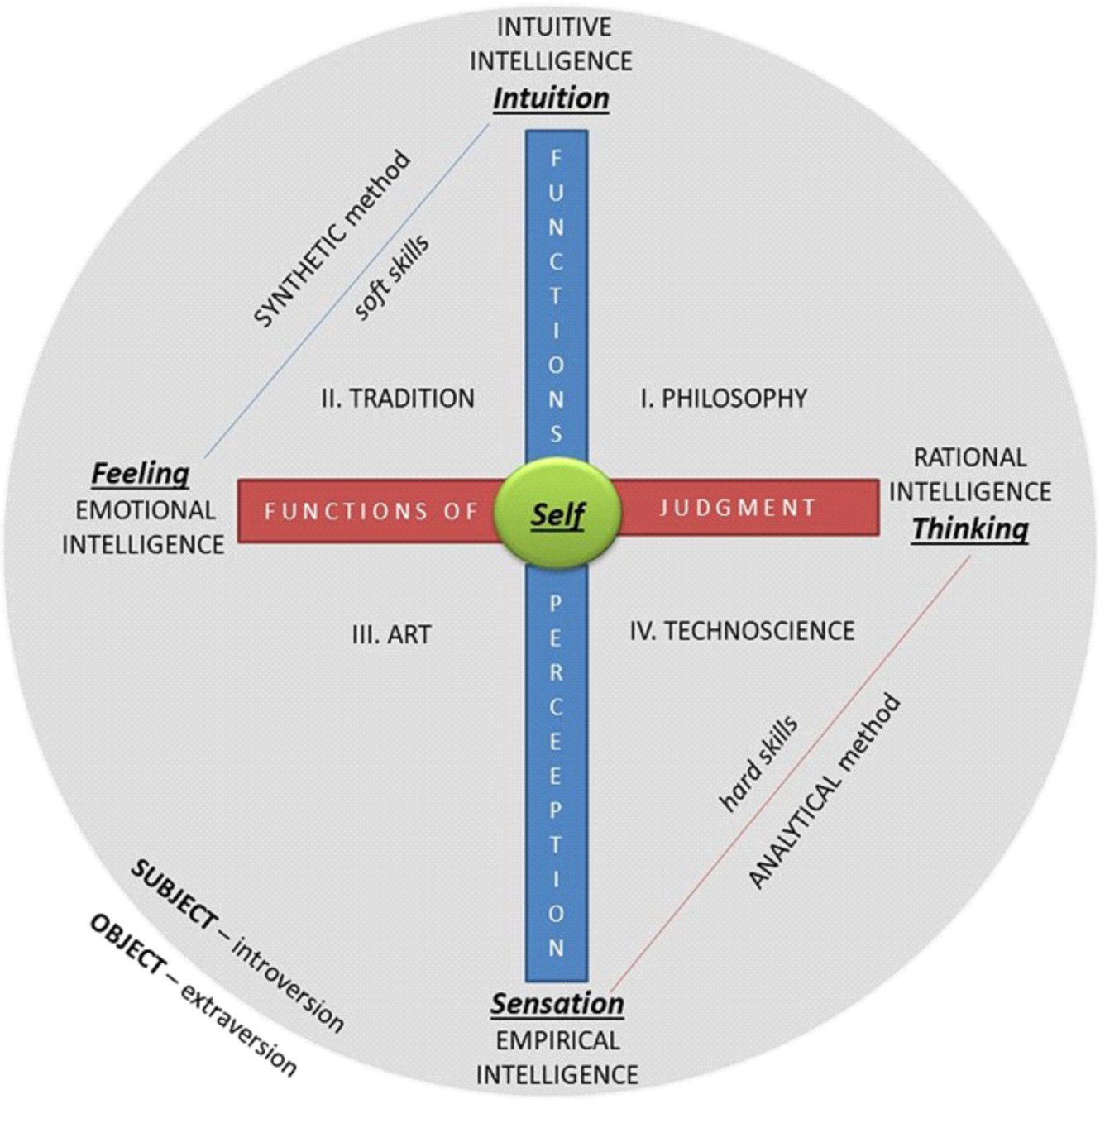
Brazilian HPTD-M approach

Slide 19
Main Building Blocks of Brazilian HPTD-M approach (first and second layers using Jungian and Myers-Briggs’ perspectives)
Combined four types of intelligence with four epistemic ways or main disciplines:
a) Technoscience (empirical, and rational intelligence)
b) Philosophy (rational, and intuitive intelligence)
c) Alchemical tradition (intuitive, and emotional intelligence) (no separation between disciplines)
d) Art (emotional, and empirical intelligence)
Created four psychological functions:
a) sensation (technoscience, empirical);
b) feeling (emotional, psyche);
c) thinking (rationale, logical psyche, mental); and
d) intuition (spirit, understandings of essence, humanistic).

Slide 20
A third layer of Brazilian HPTD-M approach
TD problem solving that creates applied knowledge and applied understandings of reality depends on Hegelian dialogue (thesis-antithesis-synthesis)(resisting dualism) between two methods (using the four psychological functions):
(a) subjective synthetic methods
emotions and intuition – soft skills
(b) objective analytical methods
sensation [empirical] and thinking – hard skills

Slide 21
Final layer
Human functions of:
Judgement (judging)
emotional intelligence (feeling)
rational intelligence (thinking)
Perceptions (perceiving)
intuitive intelligence (intuition)
empirical intelligence (sensation/experiences)

Slide 22
HPTD-M in practice:
Four requirements for TD problem solving when engaged in public administration:
Analytical
(a) feasibility (empirical)
(b) rationality (reason)
Synthetic
(c) reasonableness (emotional)
(d) meaningfulness (intuitive)
Public management tends to privilege the analytical methods (feasible and rationale – control and accountability) at the expense of the human side (reasonableness, meaning, and sense) (i.e., lack of synthetic methods).

Slide 23
Brazilian HPTD-M approach

Slide 24
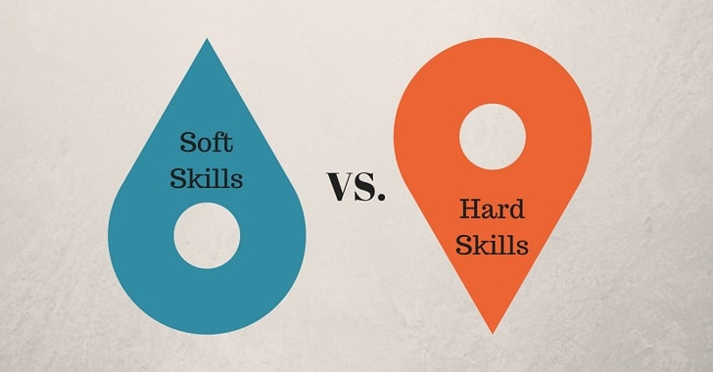
In short… the Brazilian HPTD-M holds that
TD work would reflect a concerted effort to balance
(a) concrete perceptions of facts and patterns and (b) causal logic and interpretation (hard analytical skills)
with
(c) abstract moral and ethical value judgements (wisdom and reasonableness) and (d) gut reactions, insights, and intuition (soft synthetic skills).

Slide 25

Common threads
Complexity must be accommodated
Push back against dualistic thinking
Must balance subjective with objective
Science (empirical) is not enough anymore
Focus on humanity/human side is too weak
Fragmentation and specialization are insufficient; need integration and wholism
Disciplines are not enough anymore; need to work with those living the problem
What counts as knowledge, reality, and logic must change

Slide 26
Takeaways:
If you want a new methodology (four axioms) for co-creating knowledge that is cross-fertilized, emergent, embodied, and complex – go with Nicolescu
If you think science is still most important but agree it must now work with society, go with the Zurich approach to generate socially robust, socially accountable, and socially distributed knowledge developed in context
If you think knowledge creation should employ a holistic approach that concerns understanding the actions of the whole – go with the Brazilian HPTD-M approach to generate applicable knowledge

Slide 27
Images for slides 4 and 6 are from
Mehta. K. (2019, August 30). The difference between the disciplinarities. The Lore Blog. https://blog.lore.online/2019/08/30/disciplinarities.html

