Slide 1

Consumer Moral Leadership – Responsibly Influencing the Marketplace Sue L. T. McGregor PhD, IPHE, Professor Emerita (MSVU) www.consultmcgregor.com
Ontario Home Economics Association
Fall Speaker Series
November 10, 2022 (Zoom)

Slide 2
Good Evening
Tonight’s event raised the query “Who has the greatest influence on the consumption and production of household goods — consumers or producers?”
Respectfully, I chose to bring a normative spin to this “night of philosophy” – “Who should have the greatest influence, and why?”

Slide 3
GDP and Consumer Power
I believe home economics has relied too heavily on the assumption that consumers must be empowered to be ethical and efficient managers of their own resources (with the recent imperative of sustainability).
We have not paid enough attention to consumers being leaders in the marketplace while in service to others and the Earth – responsibly exercising their power and influence.
Worse, we have historically assumed that consumers serve the economy... their major contribution is to keep it strong, vibrant, and healthy.
FYI: I challenge this assumption … as a social institution, the economy exists and is obligated to serve consumers not the other way around.
With that in mind, I will begin my conversation with the GDP and consumer power.

Slide 4
GDP and Consumer Power
The Gross Domestic Product (GDP) deals with who is spending money in a nation’s economy to keep it going – namely consumers, businesses, and governments.
Household spending is the amount consumers spend to meet their everyday needs, such as food, clothing, housing, energy, transport, durable goods, services, health costs, leisure, education, and so on.
Consumer spending is typically around two thirds (65%) of the GDP.
The US Federal Reserve Bank puts consumer spending at 68% in 2022.
The Balance (20-year edited library about personal finance) puts it even higher, at 70%.
Right now, it is consumers that are keeping the economy going!
Businesses spend 18%, and Governments spend 17%.
OECD National Account Data https://data.oecd.org/hha/household-spending.htm
https://www.theglobaleconomy.com/rankings/household_consumption/
https://fred.stlouisfed.org/series/DPCERE1Q156NBEA
https://www.thebalancemoney.com/components-of-gdp-explanation-formula-and-chart-3306015

Slide 5
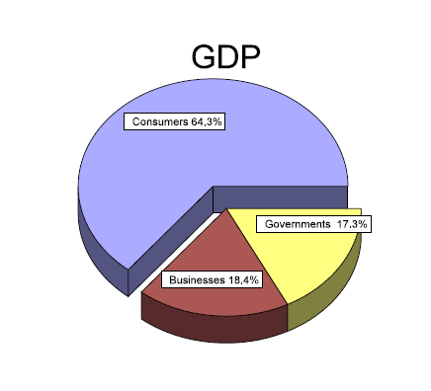
Most people are very surprised when they learn this– I know I was!

Slide 6
Consumer Responsibility
In 2020, consumers spent $64 Trillion dollars worldwide (World Bank).
That’s 12 zeros
$64, 000,000,000,000
https://data.worldbank.org/indicator/NE.CON.TOTL.CD

Slide 7
Consumer Responsibility
With this spending power comes tremendous influence and undeniable responsibility, whether desired or not, whether acknowledged or not.
Responsibility (read it backwards) literally means having the ability to respond.
When acting responsibly, people act independently and make decisions without being told to do so by someone else – they act with an internal imperative.
This definition of being responsible opens the door to a discussion of moral consumption in conjunction with ethical consumption – they are not the same thing.

Slide 8
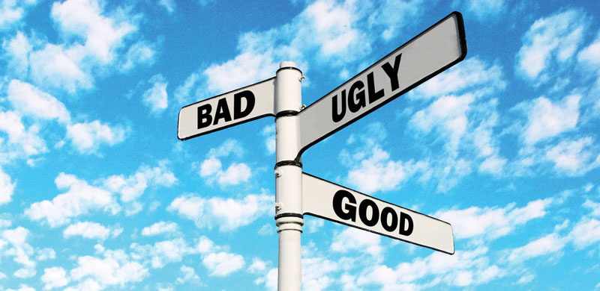
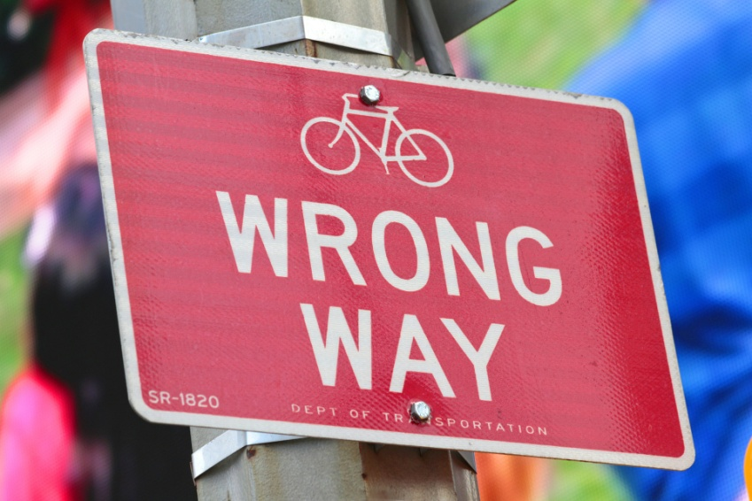
Ethical and Moral
Ethics refer to goodness or badness
Morals refer to rightness or wrongness

Slide 9
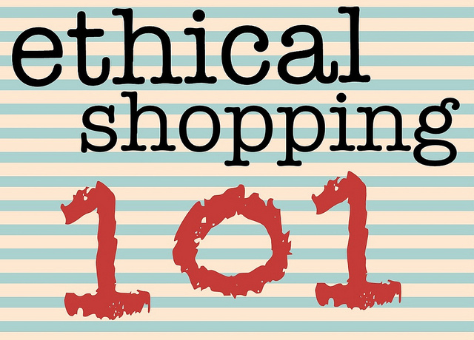
Ethical Consumption
Ethical consumption is imposed by and judged from the outside. A person’s actions are judged to be good or bad relative to an external standard or expectation (community and societal values).
Examples of ethical consumption include buying
dolphin-free tuna
foods free of GMOs
sweatshop-free clothing
fair-trade coffee or chocolate
cosmetic products free from animal testing
conflict-free diamonds

Slide 10
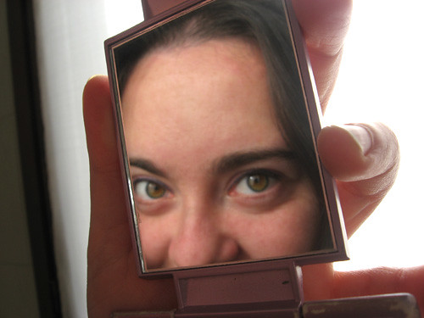
Moral Consumption
Moral consumption comes from within a person – morals are principles that people draw on to guide their decisions (right or wrong). Morality is always concerned with how others might be harmed by the consequences or fallout of one’s decisions.
Examples of moral principles are honesty, integrity, courage, respect, compassion and caring, fairness, no harm, loyalty, empathy.
People should be able to look at themselves in the mirror after consuming and feel morally justified in their decision – they made the right decision.
For another night, I have thoughts on all the excuses people can use to justify unethical and immoral consumer behaviour.

Slide 11
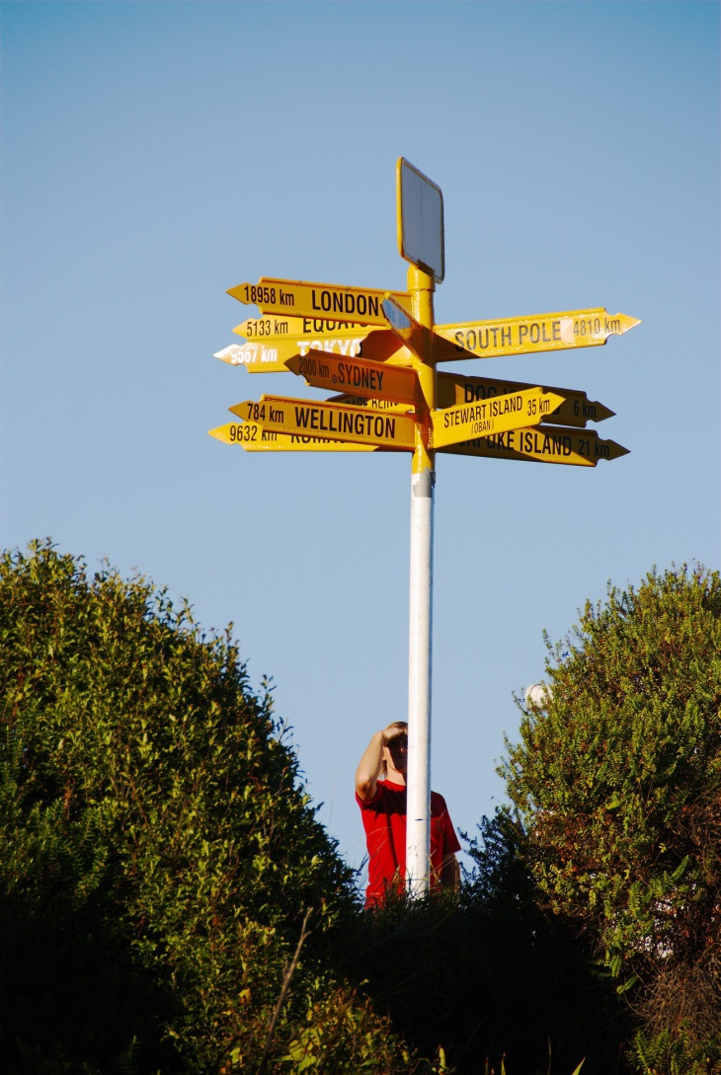
Ethics are Guideposts
Ethics are guideposts that are established by society or the community for people to follow – like signposts along a road or at intersections telling people where they will end up if they follow a particular sign or accept particular guidance – lots of chances to get lost

Slide 12

Morals are Guidelines
Morals are guidelines set by each person to guide their own decisions and any subsequent behaviour – like a rope connecting a house and a barn during a blizzard – let the line (principles) guide you, and you won’t get lost.
https://www.verywellmind.com/morality-vs-ethics-what-s-the-difference-5195271
Image source: Screen grab from Walking the line - YouTube

Slide 13
In short ….
Ethical consumerism is a type of external consumer activism – taking action at the guideposts (externally established directions and suggestions/standards).
Moral consumerism is internal and concerns whether one’s purchase decisions are principled (followed internal guidelines [the rope] to try to make the right decision).

Slide 14

Consumer Followers and Consumer Leaders
I suggest that ethical consumers are followers... they follow the guideposts – societal dictates of what is good or bad for the environment, labourers, human rights, animal rights, women’s rights, children’s rights, other species, and so on.
Followers are important because those leading the charge for ethical consumption cannot succeed if others do not follow their lead by striving to meet the ethical standards (guideposts) set for consumption that is judged to be good for everyone and everything.

Slide 15
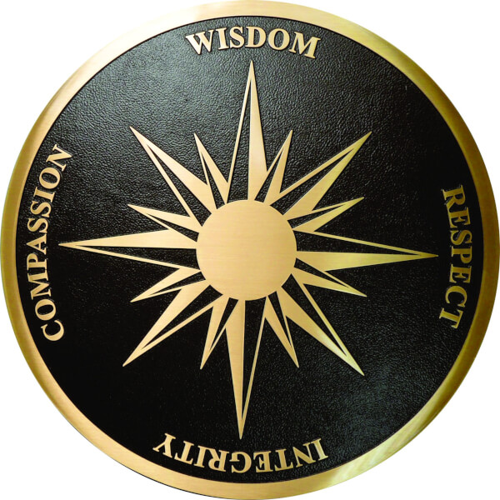

Consumer Followers and Consumer Leaders
I also suggest that it is time for consumers to become moral leaders in the marketplace by adhering to their internal principles of rightness or wrongness – their moral compass that orients them in a direction that minimizes harm (whether physical, psychological, political, ecological, cultural, and so on).
Don’t forget those 12 zeros and consumers’ collective, inordinate power and influence in the marketplace – whether they see it that way or not.

Slide 16
Caveat: Challenges of Morality
I think consumer moral leadership is an imperative, but I also appreciate that morality (determining what constitutes right or wrong) is demanding, messy, mysterious, and almost always controversial.
Basically, when making a moral decision, people can be concerned with one of three things:

Slide 17
Types of Morality
deontological (binding duty) - the intentions or motives behind their actions (they know they have a moral duty to minimize harm, and they act with that intention)
the means to the end matter
teleological (end goal or purpose) - the consequences (outcomes) to others of their actions (this concerns bringing about a better state of affairs for the greater good)
the end justifies the means
virtue - consistently acting true to their character (virtues and vices)
do not act for the wrong reason

Slide 18
Not perfect but still applicable
None of these types of morality is foolproof (i.e., things can go wrong when using them), and each has its limitations for judging something as wrong instead of right.
But ... all are viable options for making consumer decisions. It is important that we can recognize them in use, or we could make erroneous judgements and counterarguments about consumers’ actions.

Slide 19
Unprincipled consumer decisions (i.e., blind to their power and influence)*
*
Consumers would collect facts and information about the attributes of a product or service without understanding how ethics (standards of good or bad behaviour) and morals (principles of right and wrong decisions) might come into play.
They would engage in routine consumption activities instead of self-reflection and self-inquiry about the meaning of consumption (pros and cons).
They would be uncritical of their purchase decisions (i.e., no concern for power differentials) and thus blind to their power and influence.

Slide 20

Wrap up
Leaders shine a light on the future – they have a vision of where they think people should go or how things should be done. This is different from a mission, which is focused on the here and now.
Instead of narrowly focusing on ethically meeting immediate needs and wants through consumption (mission), consumer moral leaders would expand their vision of their decision process to include their inner moral compass.
They would come to appreciate that they have moral agency to lead change.

Slide 21
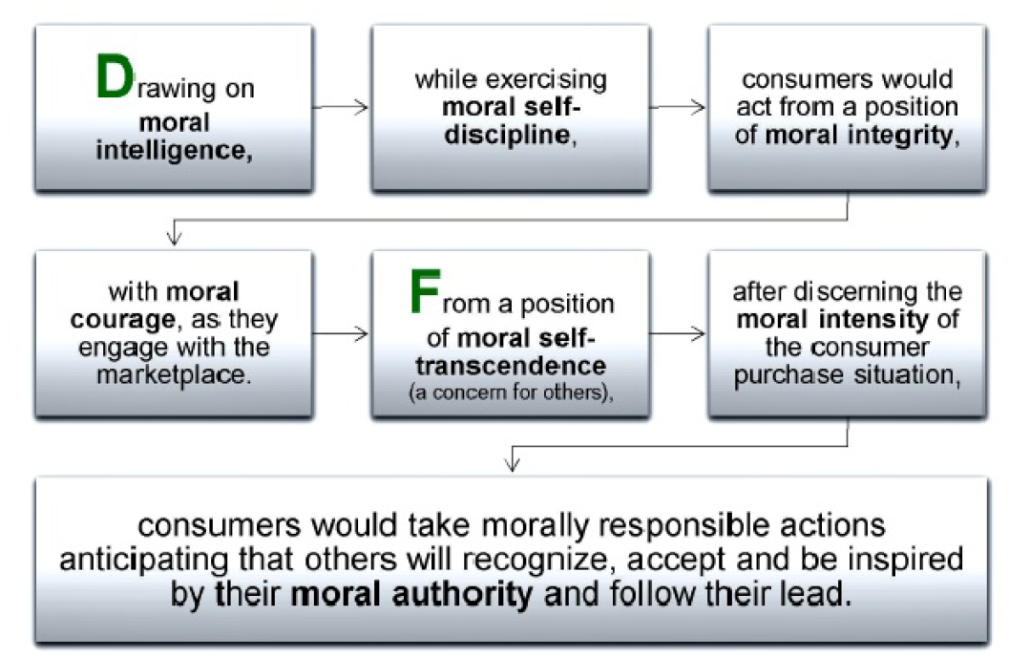
Consumer moral leadership is presented tonight as another way that consumers can responsibly influence the marketplace. I offer it as another lens through which home economists can think about this issue. I leave you with this logic and…

Slide 22
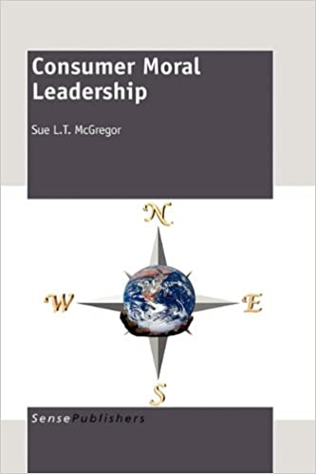
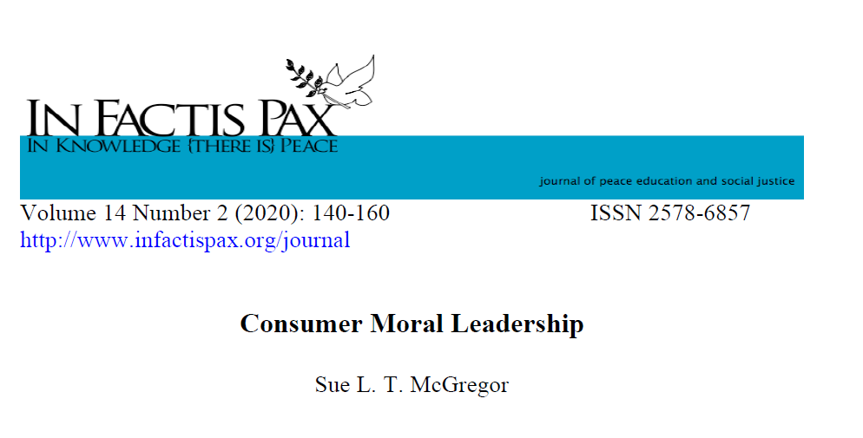
…I invite you to read more at this paper and my book.

